Slide 1
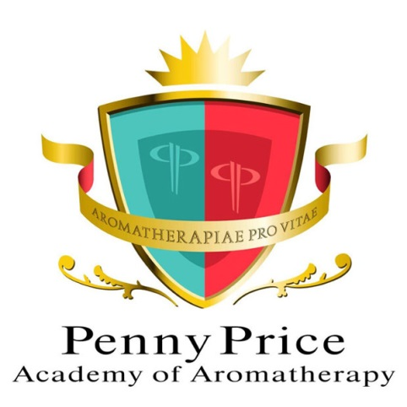
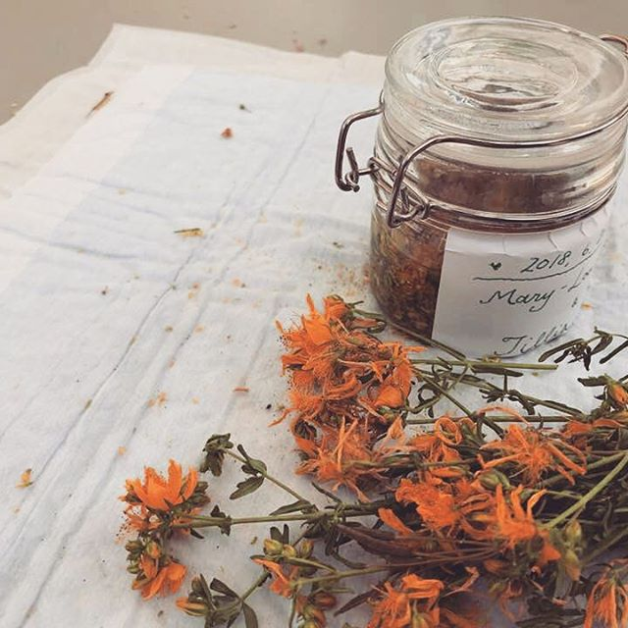
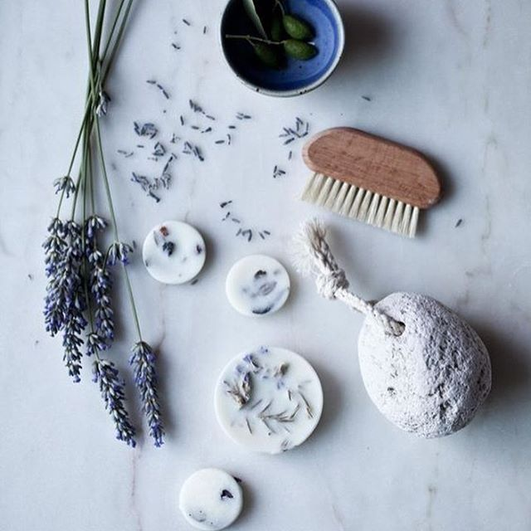
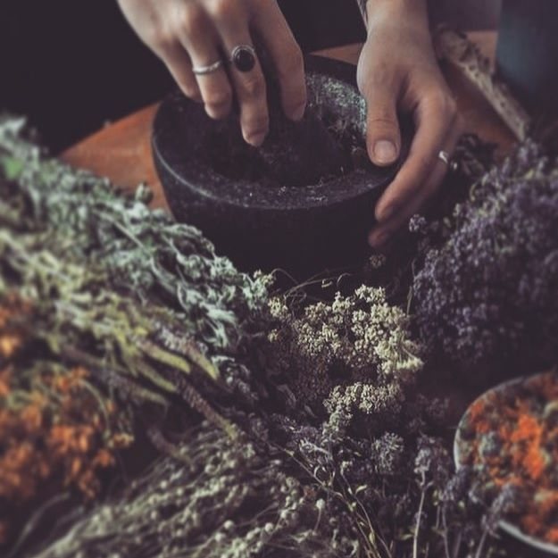
Aromatherapy for Meditation & Breathwork

Slide 2
Defining Breathwork
Penny Price Academy
Saturday Club
May 2024
Breathwork is a term for various breathing practices in which the conscious control of breathing is said to influence a person's mental, emotional, or physical state, with a therapeutic effect
The basic idea of breathwork is to release toxins and stress when you breathe out and nourish your mind and body when you breathe in.
During breathwork, you intentionally change your breathing pattern. Many forms of breathwork therapy involve breathing in a conscious and systematic way. Many people find breathwork promotes deep relaxation or leaves them feeling energized

Slide 3
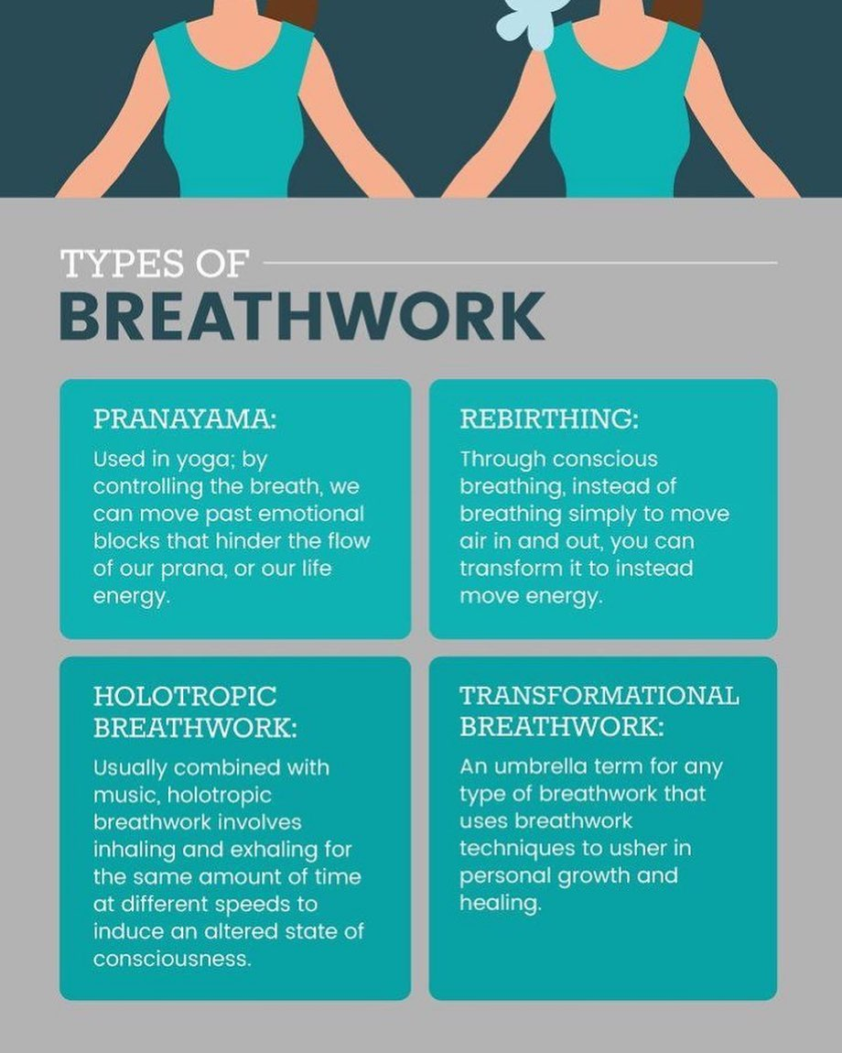
Defining Breathwork
Penny Price Academy
Saturday Club
May 2024

Slide 4
Defining Meditation
Penny Price Academy
Saturday Club
May 2024
Meditation is a practice that involves focusing or clearing your mind using a combination of mental and physical techniques. Depending on the type of meditation you choose, you can meditate to relax, reduce anxiety and stress, and more.
Defined as a practice in which an individual uses a technique – such as mindfulness, or focusing the mind on a particular object, thought, or activity – to train attention and awareness, and achieve a mentally clear and emotionally calm and stable state. Meditation is practiced in numerous religious tradition

Slide 5
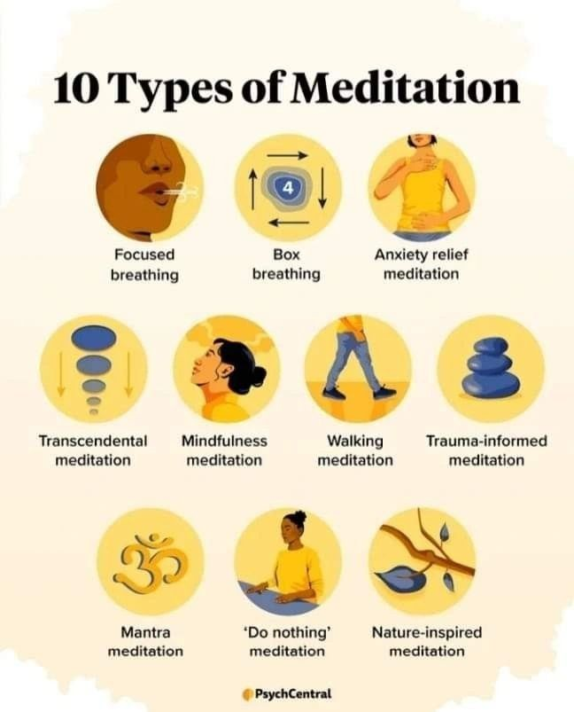
Defining Meditation
Penny Price Academy
Saturday Club
May 2024

Slide 6
Do we try to hard?
Penny Price Academy
Saturday Club
Jmay 2024
According to a new World Health Organization study not only are depression rates significantly higher in affluent nations but cases of major depression are on the rise throughout the world.
Stress is known to be one of the main triggers of depression, and in nations such as the UK a still growing number of men and women succumb to the pressures that seem embedded in our value system and social structure.
Interestingly poorer nations aren’t seeing the rise in mental illness that we do.

Slide 7
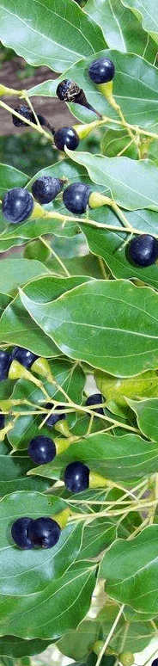
Ho Wood/Leaf Cinnamomum Camphora
Penny Price Academy
Saturday Club
May 2024
Ho wood has a beautiful, light, woody-scent that is calming, relaxing and peace-inducing for the mind and body.
The main chemical component is linalool, which has been found to have a relaxing effect upon the central nervous system one study from a small trial of 24 human subjects, using physiological parameters of heart rate, blood pressure, electrodermal activity and salivary cortisol, suggests that linalool has an anxiolytic effect (Hofel, Christ and Buchbauer, 2006).

Slide 8
Basil Ocimum Basilicum Linalool
Penny Price Academy
Saturday Club
May 2024
A beautiful top note oil that is sweet smelling due to being distilled from leaves and flowering tops.
Basil essential oil warms yang energies and lifts the spirits, cheers and strengthens the mind and it relaxes everyone I have ever used it on.
Chemically sweet basil is mainly Alcohols (linalool) which can be stimulating to the mind so make good memory aids and help clear mental chatter.

Slide 9
Lavender Lavandula Angustifolia
Penny Price Academy
Saturday Club
May 2024
Linalool also constitutes up to 45% of lavender so can explain why for so many centuries many have turned to its comforting scent for stress.
Holmes says the oil can relieve irritability and that lavender can help a person reach deeper states of meditation which in turn can help with surrendering and releasing. (Studies have shown it depresses the CNS).
Esters are very good for relieving the mind of guilt or embarrassment and helps heal those worries. They too help with irritation, anger and unreasonable behaviour. Esters encourages renewal and growth and promote feelings of warmth such as love and kindness.

Slide 10
Ylang ylang Cananga odorata
Penny Price Academy
Saturday Club
May 2024
Ylang Ylang is a deep floral scent that many fall in love with, it has an exotic edge to it and studies show that it significantly increased calmness and relaxation of a small group of participants compared to controls.
Hongratanaworakit and Buchbauer (2004; 2006) also found a significant decrease in heart rate and blood pressure with topical application and inhalation of ylang ylang aroma, supporting the relaxing properties of the oil. It also happens to be one my favourites!

Slide 11
Vetiver Vetiveria Zizanoides
Penny Price Academy
Saturday Club
May 2024
A heady scent that isn’t always favoured but can be very effective.
It is recommended for physical, mental and emotional exhaustion as it completely calms the mind.
It contains mostly vetiverol which is an alcohol so it has similar benefits to other alcohol full oils of aiding relaxation of the mind and giving the person a feel of comfort.
Energetically it clears heat, nourishes calm and uplifts.

Slide 12
Frankincense Boswellia carteri
Penny Price Academy
Saturday Club
May 2024
In addition to alleviating and eliminating low moods, Frankincense is known as the “Oil of Truth”, revealing deceptiveness and false truths.
It invites the individual to let go of lower vibrations, insults, and negativity. This oil helps create new perspectives based on integrity and enlightenment.
Mojay recommends Frankincense to help cease mental chatter and for stilling the mind.

Slide 13
Methods of use
Penny Price Academy
Saturday Club
May 2024
Diffuser or nasal inhaler
Combined with a meditation practice on a tissue or burner
Creating bespoke blends such as bath oils or pulse point rollerballs
Added to hydrolat to make an aura/meditation spray

