Slide 1
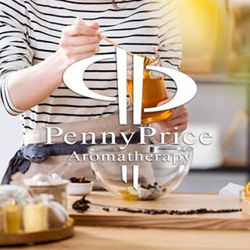
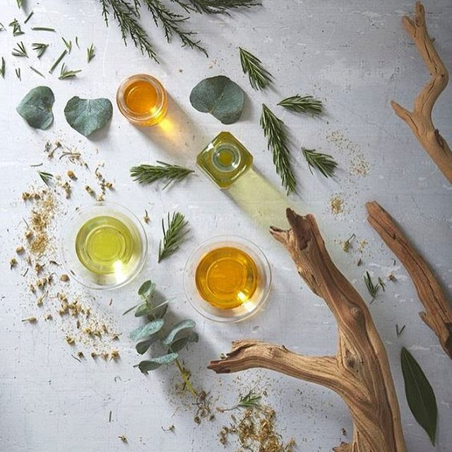
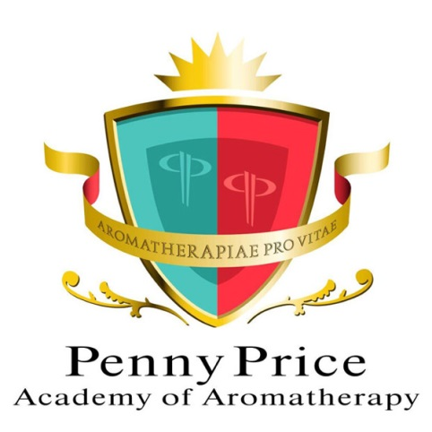
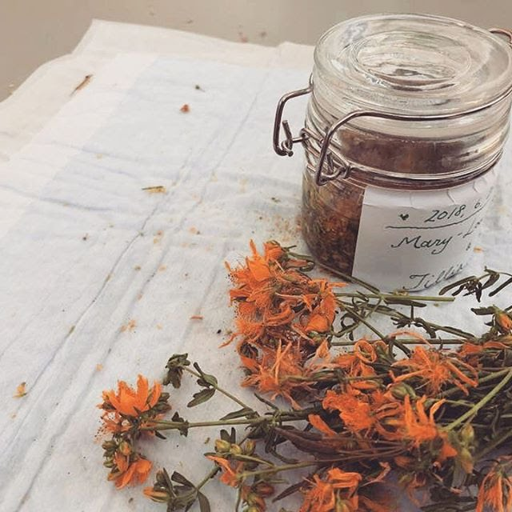
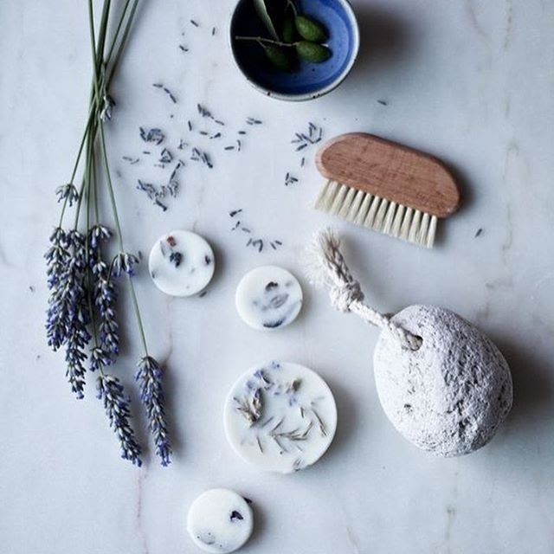
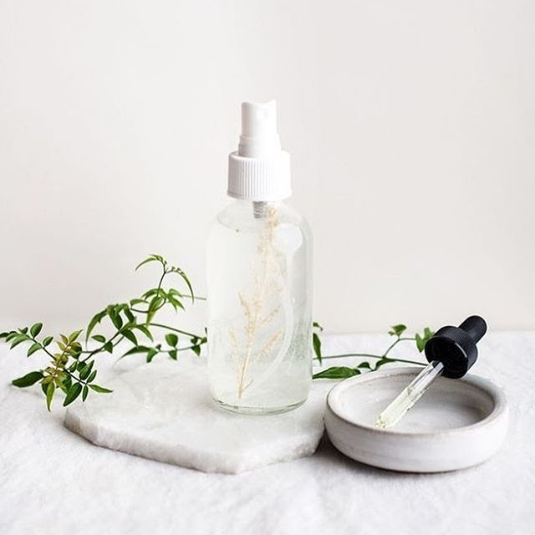
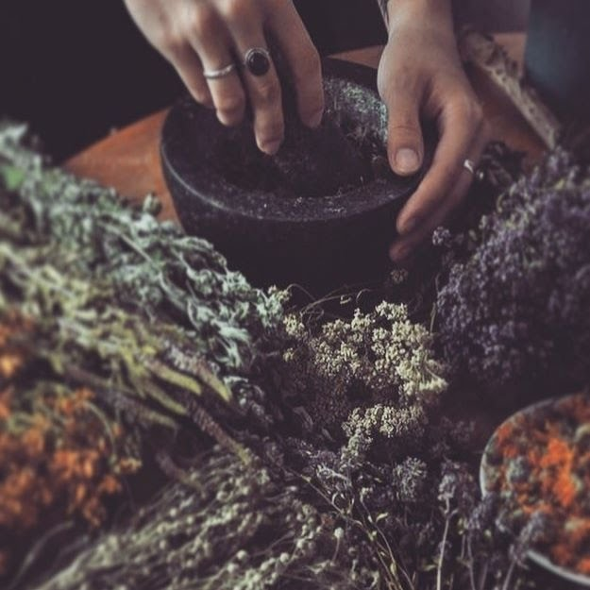
Welcome to…
Penny Price Academy
of Aromatherapy
Saturday Club
Coping with Caring

Slide 2
Issues for Carers
Loneliness and isolation
Stress and anxiety
Anger and frustration
Disempowerment
Fear
Fatigue/lack of sleep
Grief
Guilt
Penny Price Academy
Saturday Club
April 2024

Slide 3
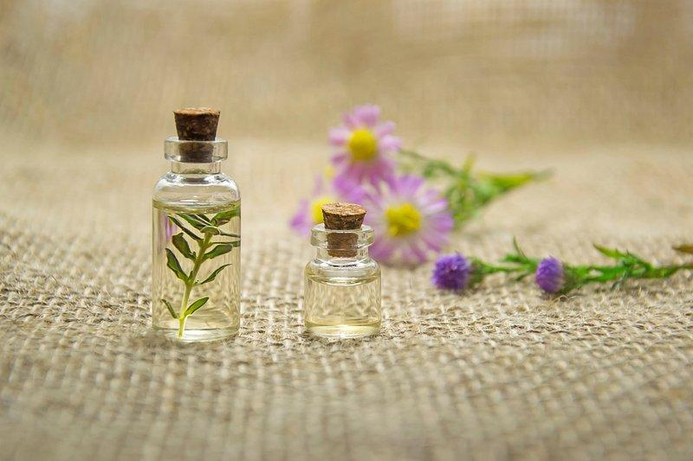
The Essential oils
Penny Price Academy
Saturday Club
April 2024

Slide 4
Cypress (Cupressus sempervirens)
Penny Price Academy
Saturday Club
April 2024
Cypress is said to help with depression particularly if it is linked with grief. Mojay recommends it for anyone who feels stuck and unable to move forward perhaps because they are overcome with loss and grief and cannot deal with it.
He states that cypress conveys a feeling of stability and cohesion. “Cypress oil’s basic subtle action is to help us cope with and accept even difficult change – of both an inner and outer nature.”
‘Cypress will create a safe, intimate sanctuary that generally supports inner fortitude and stability’ (Holmes).

Slide 5
Rose
(Rosa damascena)
Penny Price Academy
Saturday Club
April 2024
Patricia Davis associates rose as the supreme oil of the heart chakra which is the centre of love. It will help the heart chakra to open when grief has caused it to close down.
The essential oil of rose is said to bring calm in the midst of grief and heartache.
Holmes states that Rose is an emotional stabiliser and therefore is good for mood swings and will help the individual resolve chronic cycles of negative feelings.
Rose oil is said to boost self-esteem, confidence and mental strength.

Slide 6
Rose
(Rosa damascena)
Penny Price Academy
Saturday Club
April 2024
Mojay points out that the key to rose’s psychological properties lie mainly in its effect on the mind, the centre of our emotional being.
‘Rose calms and yet supports the heart, helping to nourish the heart-yin and restore a sense of well being. It is of benefit for nervous anxiety, insomnia and palpitations.’
He states that it is good for deep anxiety which has led to a fear of losing control.

Slide 7
Myrrh
(Commiphora myrrha)
Penny Price Academy
Saturday Club
April 2024
Warner states that ‘Myrrh targets our fears and insecurities, challenging us to let them go and move on.’ It also helps us to let go of our negative emotions.
Myrrh is centring, stabilising and calming. Holmes suggests that it can provide inner strength and ‘support calm perseverance in the face of severe challenges.’ He goes on to recommend it for burnout and vulnerability.
Myrrh oil’s effect on the nervous system is ‘a gentle calming one, able to instil deep tranquility of the mind.’ (Mojay).
Myrrh is also useful for grief, a healing oil with the ability to ease sorrow.

Slide 8
A blend for fear
Penny Price Academy
Saturday Club
April 2024
For fear I would suggest a roller ball ( 3-6 total drops of essential oils to 10 mls of carrier oil) or perhaps adding the oils to a bubble bath (to 10 mls of unperfumed foam bath add a total of 4-7 drops of essential oils).
Cypress - will help a person cope and will create a safe, intimate sanctuary
Rose - will calm and boost inner fortitude
Myrrh - centring, stabilising and calming, Helps us let go of fear.
Don’t forget cedarwood will give you strength to face the future.

Slide 9
Sweet Orange
(Citrus aurantium var sinensis)
Penny Price Academy
Saturday Club
April 2024
Holmes says that Sweet Orange’s actions are moderate and ideal for any conditions needing a gentle touch. He states it will give ‘gentle relaxation to tense, stress-related, nervous cardiovascular and digestive functions with a mild hypnotic effect.’
It is a general anti-depressant and can be used for stress or over-anxiety.
Mojay states that it is good for a negative outlook and for those who easily fly into a rage.
Research shows that orange oil is both “uplifting” and “calming,” so can be used in the morning or evening.

Slide 10
Yarrow
(Achillea millefolium)
Penny Price Academy
Saturday Club
April 2024
Mojay suggests that Yarrow can help deeply repressed anger and embitterment. He describes how the Orkney Islanders used it for melancholy.
This oil is recommended in times of life changes. ‘It can be a valuable ally in helping us let go of the old and in allowing us to move forward with the new with grace and poise’ (Peter Holmes)
Holmes also states that it can ‘help open us to clarity and insight into a challenging situation, helping us sort out the issues involved and envision future possibilities and potentials for resolution.’

Slide 11
A blend for anger
Penny Price Academy
Saturday Club
April 2024
For anger I would suggesting making up a nasal inhaler (6-10 total drops of essential oils) a roller ball ( 3-6 total drops of essential oils to 10 mls of carrier oil).
Yarrow - helpful for repressed anger.
Rose - cooling and calming
Sweet orange - good for rage, negativity

Slide 12
Benzoin (Styrax benzoin)
Penny Price Academy
Saturday Club
April 2024
Benzoin is deeply soothing, comforting and nurturing . Patricia Davis recommends it for sadness and loneliness, both cold feelings.
It is a sedative, ideal for insomnia and also helps people who overthink and worry.
Benzoin is comforting if you feel anxious, stressed, tense, worried or lonely.
Mojay also recommends benzoin for exhaustion.
Mojay states that “the ability of benzoin to help calm, centre and reassure also makes it suitable for those who feel emotionally needy and neglected”

Slide 13
Petitgrain (Citrus aurantium amara fol)
Penny Price Academy
Saturday Club
April 2024
In common with some other citrus oils, petitgrain has the ability to both relax and uplift at the same time.
Peter Holmes states that Petitgrain belongs to ‘an elite group of oils that combine regulating, relaxant and restorative actions on the nervous system.’
Petitgrain is useful for the treatment of insomnia, particularly if it is linked with loneliness and unhappiness rather than anxiety or an overactive mind.
Patricia Davis suggests that you should inhale this oil when you need mental clarity

Slide 14
Petitgrain (Citrus aurantium amara fol)
Penny Price Academy
Saturday Club
April 2024
It is a particularly useful oil for people who are lonely. Also like bergamot it can be effective for those who suffer from the winter blues or seasonal affective disorder.
As a relaxant/neurotonic it is useful for anxiety, palpitations, nervous breakdowns, nervous exhaustion and stress related conditions.
Several websites have mentioned that petitgrain encourages emotional health. It is said to help relinquish self-control as well as encourages self-acceptance, which makes it a fantastic mix for maintaining emotional health.

Slide 15
A blend for loneliness
For loneliness I would suggest adding 3-4 drops of essential oils to a diffuser perhaps at bedtime or using a roller ball during the day ( 3-6 total drops of essential oils to 10 mls of carrier oil).
Benzoin - soothing, comforting and nurturing for sadness and loneliness,
Rose - good for heartache and sorrow.
Petitgrain - particularly good for insomnia if linked to loneliness, uplifting.
Penny Price Academy
Saturday Club
April 2024

Slide 16
Elemi
(Canarium luzonicum)
Penny Price Academy
Saturday Club
April 2024
The essential oil of Elemi is uplifting and harmonising, calming stress, agitation and nervous exhaustion.
Valerie Ann Worwood states that Elemi can be ‘used in emotional healing to encourage soothing, calm stillness, compassion and peace.’
Felicity Warner writes how Elemi is valuable in helping people let go of this life and surrender to the next.
It is a gentle oil which can be used to help remove doubts and fears and help the dying step into the unknown.

Slide 17
A blend for fatigue and burnout
I would suggest that for fatigue perhaps using the oils in a bubble bath (to 10 mls of unperfumed foam bath add a total of 4-7 drops of essential oils) or add 3-4 drops of essential oils to a diffuser perhaps at bedtime.
Petitgrain - to give mental clarity and uplift.
Benzoin - good for exhaustion, warming and comforting
Elemi - recommended for nervous exhaustion
Vetiver - boosts the immune system, deeply relaxing
Don’t forget energising oils such as rosemary, peppermint, black pepper and ginger. They can be added to a nasal inhaler and sniffed during the day.
Penny Price Academy
Saturday Club
April 2024

Slide 18
Melissa
(Melissa officinalis)
Penny Price Academy
Saturday Club
April 2024
Mojay suggests that it can “help restore both clarity and security to a confused dependent soul”. “Melissa is the most effective oil for anxious depression and a feeling of foreboding”. “It replaces intensity with serenity and distrust with innocence”.
Patricia Davis writes “I have found Melissa a great help and comfort to those who know that they are dying, as well as their relatives and friends. Its sweet, fresh fragrance seems to dispel fear and regret and bring acceptance and understanding as the time of death approaches”.

Slide 19
Melissa
(Melissa officinalis)
Penny Price Academy
Saturday Club
April 2024
Physically, the essential oil of Melissa will help lower high blood pressure and has a calming effect on over-rapid heartbeat and breathing.
Several studies have shown that Melissa helps reduce anxiety and promote sleep.
Gabriel Mojay suggests that it can be used for restless insomnia and hot agitation

Slide 20
Frankincense
(Boswellia carteri)
Penny Price Academy
Saturday Club
April 2024
Frankincense is excellent for stress, it will slow the breathing and therefore calm the person, it can be used to help meditation and other tools used to calm.
It is a valuable oil for its effect on the mind being both soothing and stimulating at once, it can help the depressed person to get moving again. It seems to be particularly helpful for people suffering from the effects of traumatic experiences in their past.
On a day-to-day level it may be used for states of mental agitation and worry, or whenever the mind is distracted and overwhelmed by too many thoughts.

Slide 21
Frankincense
(Boswellia carteri)
Penny Price Academy
Saturday Club
April 2024
Felicity Warner describes how Frankincense can ‘clear away melancholy and ease the sadness that can be associated with nostalgic thoughts.’
She goes on to say that ‘it’s a marvellous aid when dealing with any kind of spiritual crisis because it not only soothes our inner chaos but it also provides spiritual comfort and protection.’
Mojay suggests it is good for the mentally overwhelmed where it can ”help cease mental chatter and still the mind ready for meditation or prayer.” He says it stops ‘mundane worry’.

Slide 22
A blend for stress and depression
Make up a nasal inhaler (6-10 total drops of essential oils) a roller ball ( 3-6 total drops of essential oils to 10 mls of carrier oil), Add any three of the following oils:
Benzoin - warming and comforting
Rose - calming and good for nervous anxiety
Elemi - calms stress and agitation
Frankincense - ceases mental chatter
Melissa - for anxious depression and a feeling of foreboding
Sweet orange - uplifting and calming
Penny Price Academy
Saturday Club
April 2024

Slide 23
A blend for guilt or regret
Make up a nasal inhaler (6-10 total drops of essential oils) a roller ball ( 3-6 total drops of essential oils to 10 mls of carrier oil), Add any three of the following oils:
Benzoin - reassuring and comforting
Melissa - to give serenity and peace
Rose - nourishing and good for negative feelings
Elemi - gives compassion and healing
Also don’t forget Pine which provides strength and assurance.
Penny Price Academy
Saturday Club
April 2024

Slide 24
A blend for grief
Penny Price Academy
Saturday Club
April 2024
I would suggest that for grief perhaps using the oils in a bubble bath (to 10 mls of unperfumed foam bath add a total of 4-7 drops of essential oils) or add 3-4 drops of essential oils to a diffuser perhaps at bedtime.
Cypress - for people overcome with loss and grief
Benzoin - comforting and nurturing
Myrrh - a comforting gentle oil to ease sorrow
Rose - rose is said to bring calm in the midst of grief and heartache.
Elemi - helps people who are dying to let go
Melissa - as a preparation for death

Slide 25
Recommended books
Penny Price Academy
Saturday Club
April 2024
Gabriel Mojay - Aromatherapy for Healing the Spirit: Restoring Emotional and Mental Balance with Essential Oils
Patricia Davis - Aromatherapy An A-Z
Peter Holmes - Aromatica: A Clinical Guide to Essential Oil Therapeutics. Principles and Profiles vols 1 and 2
Valerie Ann Worwood - The Fragrant Mind
Felicity Warner - Sacred Oils

