Slide 1
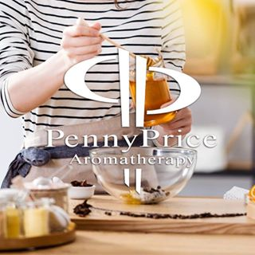
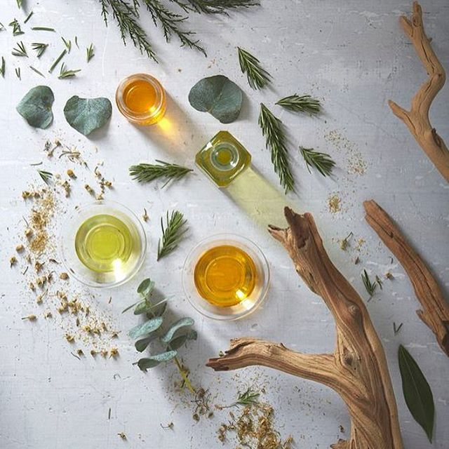
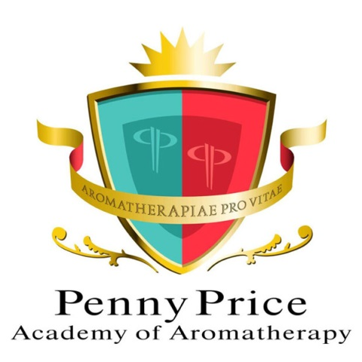
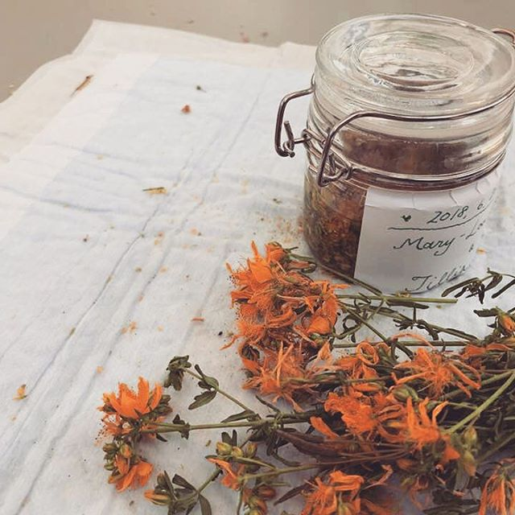
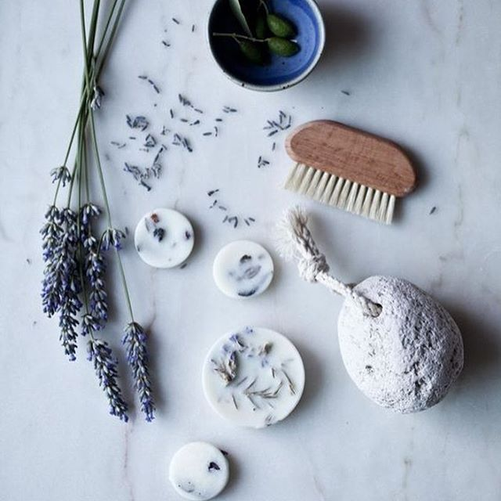
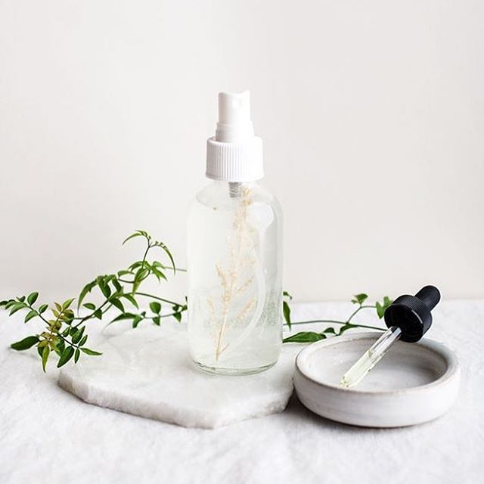
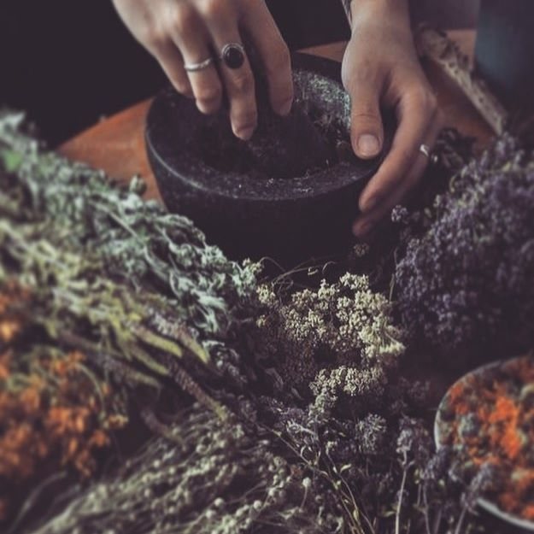
Saturday Club
We’re all going on a Summer Holiday!
July 13th 2024

Slide 2
Looking forward to going away?
Penny Price Academy
Saturday Club
XXXX 2023
I’m sure we all look forward to our holidays- a break away from our normal routine and time to relax and recharge?
How can we enhance our time away from home by being prepared for some of the natural events and disasters which trip up our relaxation?
With the power and versatility of our Essential oils, of course…..

Slide 3
Penny Price Academy
Saturday Club
XXXX 2023
Many of us get a bit agitated before travelling- especially if we’re going somewhere unfamiliar or undertaking a long journey. This stress is perfectly normal, but can detract from our pleasure and ease of planning – what to take, what happens if someone gets sick, getting everything ready….
How can we combat this and enjoy the journey as well as the destination?

Slide 4
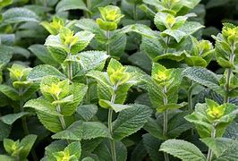
Peppermint (Mentha piperita)
Penny Price Academy
Saturday Club
XXXX 2023
A versatile oil, especially useful to cool the emotions, to help settle un unsettled stomach and fight off viruses and alleviate pain. This is a holiday essential!
A few drops on a tissue or handkerchief (in a plastic bag) can be inhaled during a journey to help combat a queasy tummy, or rubbed onto the back of the neck to cool and relieve headaches caused by stress and tension.
Peppermint has been used through the centuries to cool, calm and freshen- the remnants of leaves have been found in the Mummies of ancient Egypt and its properties have been referenced in ancient Greek text… If you want to boost and synergise, you can combine with….

Slide 5
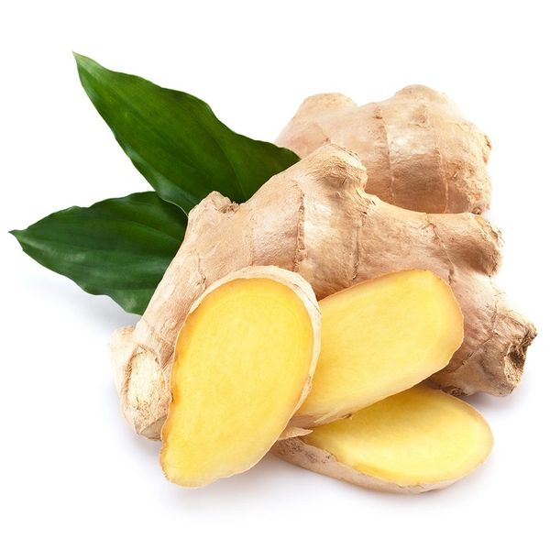
Ginger (Zinginber officinalis)
Penny Price Academy
Saturday Club
XXXX 2023
While Peppermint cools, Ginger warms and comforts, boosting confidence and cheering the spirits.
A great oil for digestive complaints, it also fortifies the circulation, making it useful for tired legs on long journeys!
Ginger (and lemon) teas can be helpful to settle an upset tummy, many blends are available in the supermarket (we wouldn’t advocate taking the EO internally….) and taking a few teabags in your luggage isn’t difficult- even when travelling light!
You can also grate or slice a little root ginger, a slice of lemon and some peppermint leaves- steep in boiled water and leave to cool, sipping when on a journey will be refreshing, calming and settling!

Slide 6
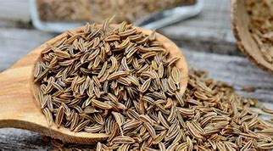
Caraway (Carum carvi)
Penny Price Academy
Saturday Club
XXXX 2023
One you might be less familiar with- Caraway has been used for digestive upsets, to calm
and soothe the nerves, and relieve flatulence.
Uplifting and soothing, this makes a good addition to your travel sickness blend.
It also helps alleviate coughs and calms menstrual cramps, so helpful in a number of situations!
On you travel tissue- a couple of drops of Peppermint, Ginger and Caraway, and/or a blend of 2 drops of each in 20ml of carrier or white lotion to be massaged across the shoulder can be helpful for both stress and anticipation and the associated stomach problems.

Slide 7
Penny Price Academy
Saturday Club
XXXX 2023
So, we’ve arrived at our holiday destination, and our hotel or holiday cottage is lovely, but smells a bit musty or just not like home….
Take a small spray bottle with a blend of Eucalyptus, Lavender and Thyme will drive away the mustiness, calm and protect from unwanted bugs!
Now to enjoy some sunshine (fingers crossed….)
But what to do if we get a bit too much?

Slide 8
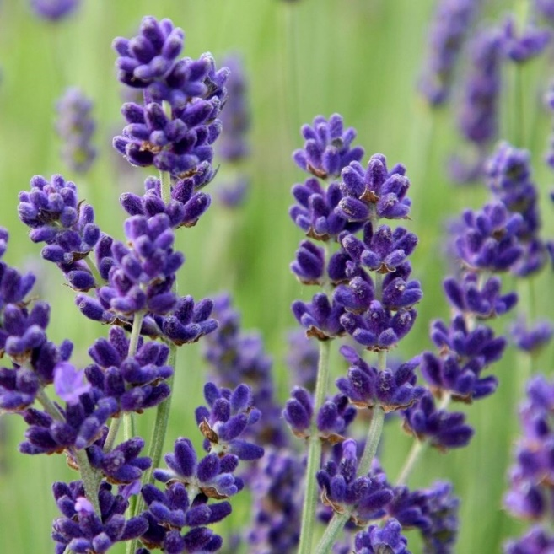
Lavender (Lavandula angustifolia)
Penny Price Academy
Saturday Club
XXXX 2023
The much loved, and reliable Lavender is unbeatable for soothing tired and
overstressed skin. Lavender is also
antibacterial, anti-inflammatory and cicatrisant- so useful to combat holiday bugs and uspets.
Blend with Peppermint in a white lotion to calm hot and over-exposed skin, this can help relax and encourage restful sleep, ready to face another day of sunning and activity.

Slide 9
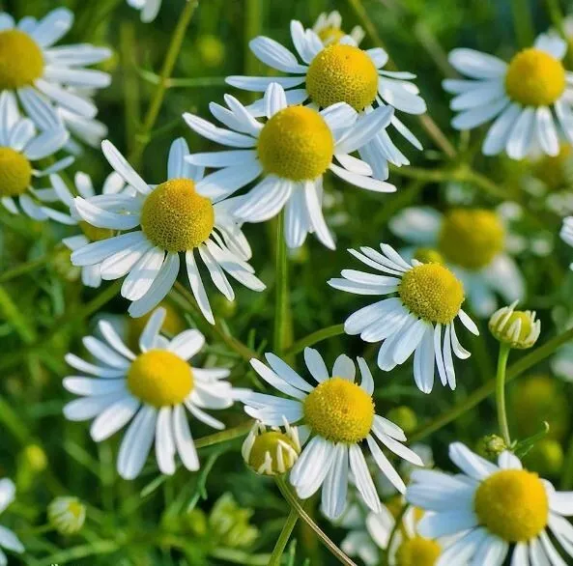
Chamomile German (Matricaria chamomilla)
Penny Price Academy
Saturday Club
XXXX 2023
The chamomile family are fantastic
anti-inflammatory and calming oils. Helpful
for indigestion, headaches and anxiety- this oil is a useful addition to your holiday toolkit.
Add a few drops to your white lotion to calm and soothe, this can be added to your bedtime bathwater to relax and wind down after a busy day, and will ease the discomfort of over- exposed skin at the same time.

Slide 10
Penny Price Academy
Saturday Club
XXXX 2023
Other troublesome issues that can spoil our relaxation?
Those troublesome flyers….
Insects- prevention, bites and stings….

Slide 11
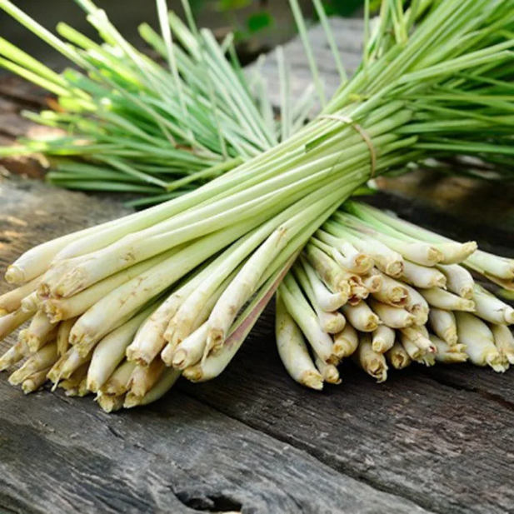
Lemongrass (Cymbopogan flexuosus)
Penny Price Academy
Saturday Club
XXXX 2023
Traditionally used for infections, fever and
as an insecticide, Lemongrass is analgesic, antiseptic and deodorant.
It is useful as an insect repellent, and to calm indigestion, fevers and nervous exhaustion.
Always use in a blend, this oil has a strong aroma and colour- neat it can stain and irritate, the fresh aroma is a great ‘wake up’ oil for first thing in the morning.

Slide 12
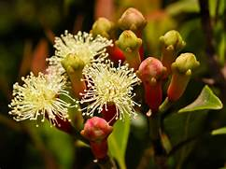
Clove Bud/Leaf (Syzigium aromaticum)
Penny Price Academy
Saturday Club
XXXX 2023
Clove is another oil with a strong and powerful aroma- and one of the strongest antiseptic oils available to us. Useful for digestive upsets as well as keeping bugs and flying insects at bay- use with care, especially with the very young or frail and never neat on the skin (it can cause irritation)
A spray bottle of Peppermint hydrolat with Lemongrass, Clove and Eucalyptus oils can be useful to spritz if you are prone to attracting mosquitos- this will keep you cool (but don’t over do it- the smell might not suit everyone!)

Slide 13
Thank you for joining us today, I hope you’ve enjoyed exploring ways to enjoy our holidays with the help of our oils!
Today’s featured oils are:
Peppermint
Ginger
Caraway
Lavender (French)
Chamomile German,
Lemongrass
Clove Bud/Leaf Use Code: SatClub
For 10% off these oils
Next Saturday club by Zoom, with Louise Mac, 10th August, the topic is Skin Trends….

