Slide 1
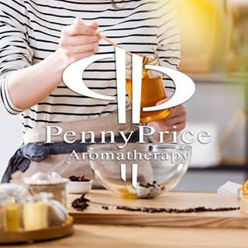
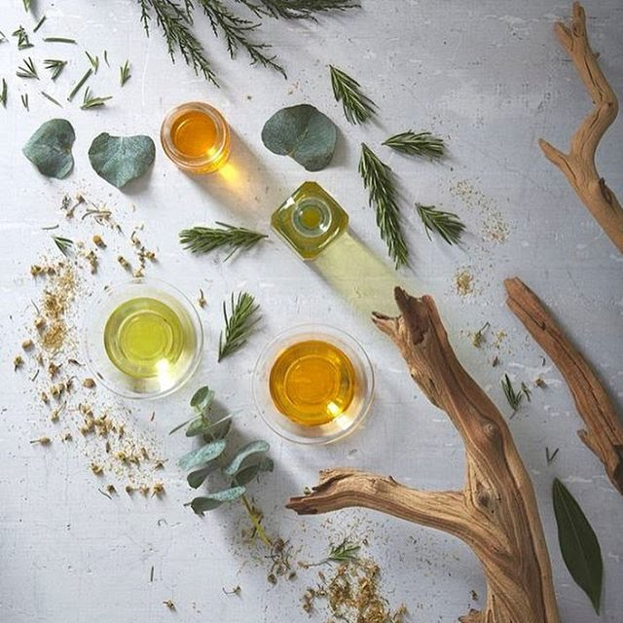
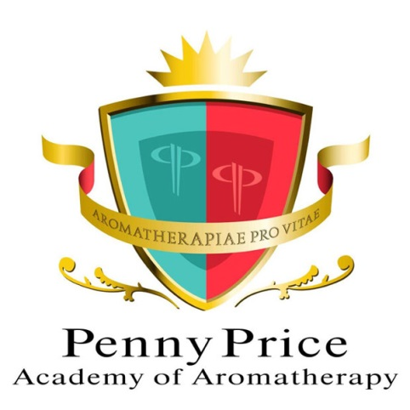
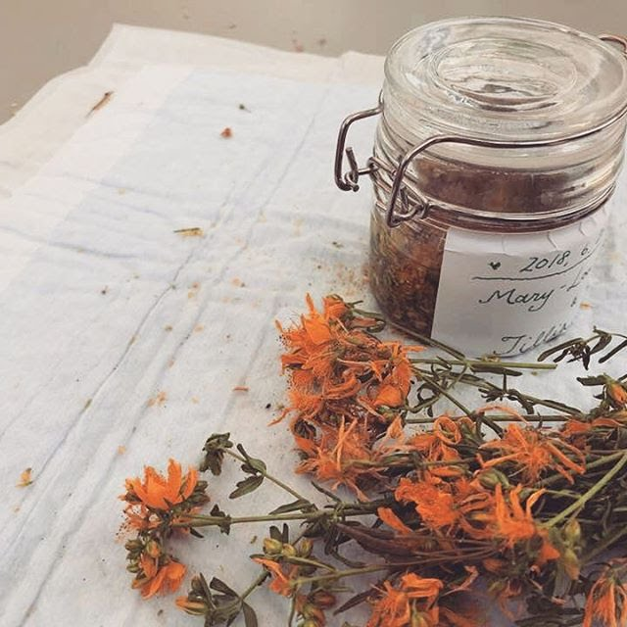
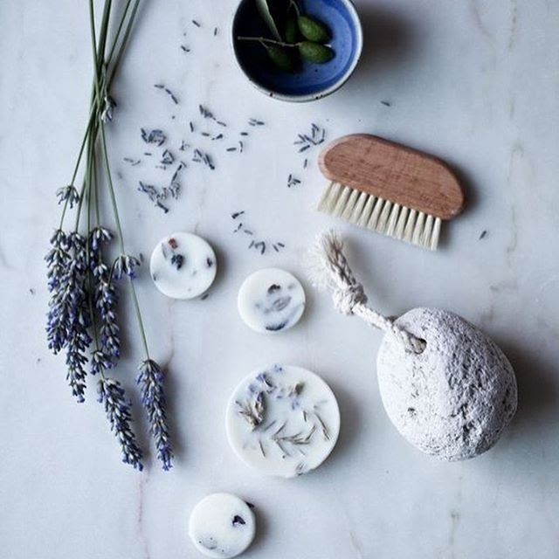
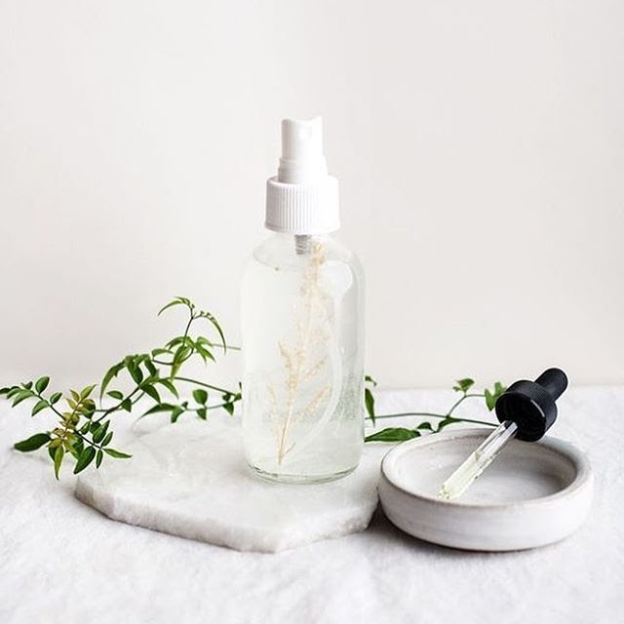
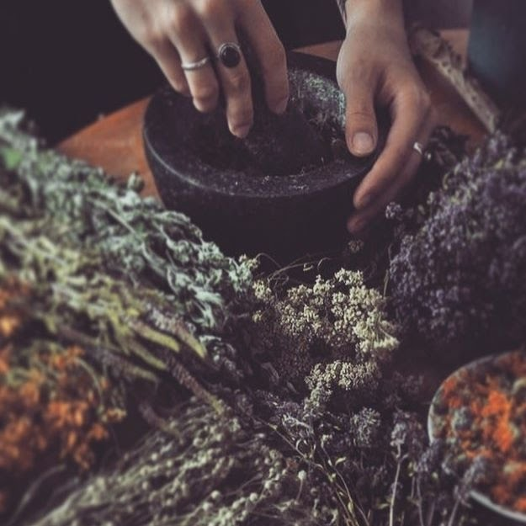
Welcome to…
Penny Price Academy
of Aromatherapy
Saturday Club
Aromatherapy from the
garden

Slide 2
Benefits of walking through your garden
One of the largest studies to date on gardens and gardening, funded by Innovate UK and National Institute for Health Research, found that people who spent time in the garden report better physical and mental health levels than those who do not.
Another study concluded that time spent in natural settings can help reduce mental fatigue recovery time and improve concentration levels.
Being around plants has been shown to decrease the cortisol levels in the body resulting in less stress and consequently better overall health.
Penny Price Academy
Saturday Club
June 2024

Slide 3
Your garden
The fragrances in your garden have the power to modify our brain and frame of mind. Inhaling their aromas is a powerful form of natural therapy
Some plants release oils when you touch the leaves:
Lavender - calming
Rosemary - stimulating
Thyme - antibacterial, good for coughs
Peppermint - increases alertness, cleanses the mind
Penny Price Academy
Saturday Club
June 2024

Slide 4
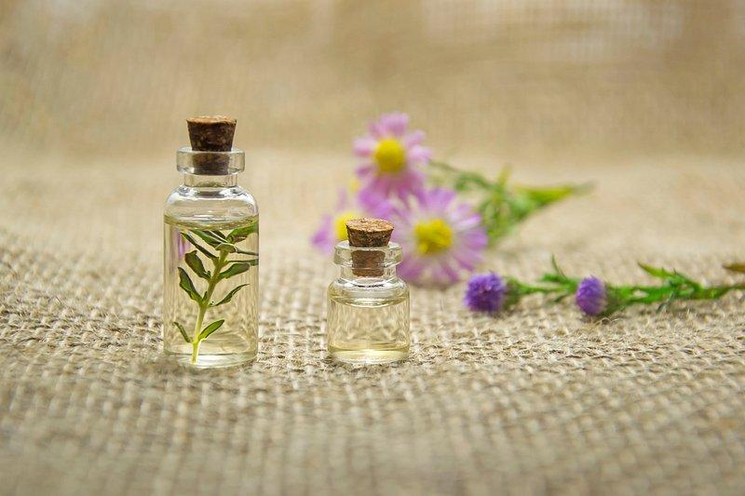
The Essential Oils
Penny Price Academy
Saturday Club
June 2024

Slide 5
Geranium
(Pelargonium graveolens)
Penny Price Academy
Saturday Club
June 2024
Geranium essential oil has stimulating and regenerating properties which can be used as a body skincare product for all skin types.
It can help normalise excessively dry or oily skin, and is effective for inflamed conditions of the skin such as eczema as it is anti-inflammatory and antiseptic.
This oil also naturally repels insects. To keep your home free of mosquitoes and other winged insects, spray geranium oil throughout the room. To maximize the effects, Patricia Davis recommends combining with bergamot, lemon or citronella.

Slide 6
Geranium
(Pelargonium graveolens)
Penny Price Academy
Saturday Club
June 2024
Geranium essential oil is an adrenal cortex stimulant and has a balancing effect on general hormone production.
This balancing effect makes it a valuable oil during the menopause and also for premenstrual syndrome (when it will help disperse fluid retention and relieve depression).
Lawless states that the oil uplifts mood and also helps to calm anxiety and nervous tension brought on by stress.
Mojay suggests that it can give a feeling of calm strength and security and therefore, is beneficial for both chronic and acute anxiety, particularly when the stress is due to overwork.

Slide 7
Sage
(Salvia officinalis)
Penny Price Academy
Saturday Club
June 2024
Holmes states that sage is ‘a superb oil for chronic weak cold and to some extent damp conditions.’ It is recommended for chronic fatigue syndrome, convalescence, chronic or recurring infections.
French practitioners consider the oil a prime detoxicant working both on the liver and kidneys.
Sage essential oil is oestrogen like and therefore can be used to regulate the menstrual cycle. It is particularly beneficial for treating delayed, scanty or no menstruation and for menopausal problems particularly sweating. It is also said to bring rapid relief in the case of painful periods.

Slide 8
Sage
(Salvia officinalis)
Penny Price Academy
Saturday Club
June 2024
Sage is reputed to be highly regenerative in skin care. Schnaubelt recommends a blend of sage, helichrysum and rosehip oil for slow healing wounds. He suggests two applications per day for 10 days on a recent wound or for 3-6 months for old scars.
Holmes suggests that sage is for ‘the individual burdened with feeling unmotivated, discouraged and depressed that their life is going nowhere but lacking the braveness to come to terms with his or her malaise…. the oil can help summon the necessary courage needed to overcome internal resistance.’

Slide 9
Thyme ct Linalool
(Thymus Vulgaris ct linalool)
Penny Price Academy
Saturday Club
June 2024
The essential oil of thyme ct linalool is very gentle – its composition is fairly similar to that of Lavender.
It is an excellent anti-infective oil that can address a wide spectrum of fungal, bacterial and viral infections. It is recommended for chronic, not acute infections. It has been shown to help with chronic coughs and is a bronchial restorative.
Thyme oil is a digestive stimulant and carminative. It is said to promote appetite, ease abdominal distention and relieve flatulence.

Slide 10
Thyme ct Linalool
(Thymus Vulgaris ct linalool)
Penny Price Academy
Saturday Club
June 2024
Thyme essential oil has progesterone balancing effects; it benefits the body by improving progesterone production.
Many women in midlife become low in progesterone as they approach menopause. Low progesterone is associated with insomnia, mood swings, weight gain and hot flushes
Mojay describes this oil as fortifying and uplifting, he states that ‘thyme oil can be used for poor self-confidence, apathy and fear.’

Slide 11
A blend to balance hormones
Add a total of 6 drops of any of the following essential oils to 20 mls cream base or 20 mls of carrier oil
Geranium - valuable oil during the menopause and also for premenstrual syndrome.
Sage - regulates the menstrual cycle, beneficial for treating delayed, scanty or no menstruation and for menopausal problems It is also said to bring rapid relief in the case of painful periods.
Thyme - benefits the body by improving progesterone production to help hot flushes, infertility, PCOS and depression.
Penny Price Academy
Saturday Club
June 2024

Slide 12
Basil ct linalool
(Ocimum basilicum)
Penny Price Academy
Saturday Club
June 2024
Basil is a stimulant and tonic and is good for a variety of respiratory conditions. It opens up the sinuses and nasal passages which allows easier breathing for sufferers of asthma, allergies, bronchitis and sinusitis.
The antispasmodic properties make it useful in the treatment of whooping cough and asthma.
In a massage blend (particularly when combined with Lavender) Basil is good for tired and overworked muscles due to exercise. It is particularly recommended for athletes who are involved in continuous strenuous exercise.

Slide 13
Basil ct linalool
(Ocimum basilicum)
Penny Price Academy
Saturday Club
June 2024
Basil is an antispasmodic and digestive, and is useful in an abdominal massage to ease many digestive problems such as indigestion, flatulence, nausea and IBS.
Like Rosemary, Basil is a brain stimulant and therefore, can be used for mental fatigue, poor memory and in situations when concentration is required.
It is a neurotonic and therefore, is indicated for anxiety and stress related problems. It is also an antidepressant.

Slide 14
Rosemary
(Rosmarinus officinalis)
Penny Price Academy
Saturday Club
June 2024
Rosemary has stimulating properties which are particularly useful if a system has become sluggish. It can help ‘get things moving’ when constipated. It can also help cellulite when used in massage.
In massage rosemary essential oil can be used for muscular pain especially for ‘overworked’ muscles following sports, gardening etc. It is also very helpful for pain relief in arthritis particularly if the joints feel cold.
Rosemary’s stimulant effect on the central nervous system is very marked, and for this reason rosemary may help where there is a reduction or loss of function, such as loss of smell.

Slide 15
Rosemary
(Rosmarinus officinalis)
Penny Price Academy
Saturday Club
June 2024
There have been several studies concluding that Rosemary can improve the memory and could be beneficial to patients with dementia.
Sniffing a little rosemary before an exam or event that requires an alert mind can be very helpful. ‘There's rosemary, that's for remembrance’ (Shakespeare).
‘It warms the spirit and makes it bold.’ Rosemary is suited to the cold, debilitated individual who has a poor sense of self worth and who lacks a strong healthy ego. (Gabriel Mojay)

Slide 16
A blend to help with fatigue
For mental fatigue I would suggesting making up a nasal inhaler (6-10 total drops of essential oils) or a roller ball ( 3-6 total drops of essential oils to 10 mls of carrier oil).
For physical fatigue try adding a total of 3 drops of essential oil to 10 mls of plain shower gel.
Basil - brain stimulant which can be used for mental fatigue, poor memory and in situations when concentration is required.
Sage - recommended for Chronic Fatigue Syndrome
Rosemary - stimulating, good for the memory
Penny Price Academy
Saturday Club
June 2024

Slide 17
Rock Rose
(Cistus ladaniferus)
Penny Price Academy
Saturday Club
June 2024
Rock rose essential oil is both anti-inflammatory and antiseptic making it highly soothing for the skin. It can be used for sunburn, acne, eczema, psoriasis or an allergic reaction to calm the affected area.
This oil is an astringent and therefore can reduce the appearance of wrinkles and fine lines.
When inhaled it evokes feeling of peace and tranquility and therefore can be used in meditation. The Ancient Egyptians used its therapeutic properties in their famous incense, Kyphi, which was used to alter the mood and stimulate feelings of euphoria.

Slide 18
Roman Chamomile (Anthemis nobilis)
Penny Price Academy
Saturday Club
February 2024
Roman chamomile is similar in its effects to lavender, being calming, soothing and helpful with stress and anxiety.
It is high in esters and physically is one of the best oils for calming physical tension - spasm, inflammation and accompanying pain.
A small-scale 2021 study found that chamomile essential oil significantly improved sleep quality among 20 university students who experienced poor sleep quality.
Peter Holmes describes it as a good hypnotic for stress related conditions and recommends it for nightmares.

Slide 19
Roman Chamomile (Anthemis nobilis)
Penny Price Academy
Saturday Club
February 2024
This oil is an anti-inflammatory and is soothing and calming to the digestive system. It promotes secretion of digestive juices into the stomach and facilitates digestion,
It is also useful for many skin conditions particularly where the skin is very sensitive, chapped, reddened or dry. Because it causes small blood vessels to contract it can help reduce redness of cheeks due to enlarged capillaries
‘The chamomiles help us let go of fixed expectations, calmly acknowledge our own limitations and more readily accept the help and support that others can manage to give.’ (Mojay)

Slide 20
Carrot Seed
(Daucus carota)
Penny Price Academy
Saturday Club
June 2024
Battaglia states that carrot seed essential oil is a powerful hepatic, depurative and diuretic. It is also an ‘excellent regenerator of liver cells.’
Carrot seed oil is a skin cell regenerator which will help to tone and tighten skin whilst repairing damage and signs of ageing. It is recommended for dull, lifeless and tired skin.
As a purifier it can be helpful for eczema, psoriasis and ulcerative conditions of the skin.
Carrot Seed oil is also said to boost the spirit, helping to calm an overactive mind and soothe emotional stress.

Slide 21
Two beautiful blends for the skin
Add a total of 6 drops of any of the following essential oils to 20 mls cream base
Aging Skin
Carrot - skin cell regenerator which will help signs of ageing
Rock rose - can reduce the appearance of wrinkles and fine lines
(Together with either frankincense or neroli).
Problem skin
Rock rose or geranium - anti-inflammatory and antiseptic
Carrot - helpful for eczema, psoriasis and ulcerative conditions of the skin.
Chamomile - soothing and anti-histaminic
Penny Price Academy
Saturday Club
June 2024

Slide 22
Yarrow
(Achillea millefolium)
Penny Price Academy
Saturday Club
June 2024
Yarrow was originally known as Soldier’s Wound Wort and was used to help wounds in battle.
It is antiseptic, astringent and anti-inflammatory and can help with wounds, irritated skin and infections.
It’s soothing properties when applied in a carrier oil may help to soothe and reduce inflammation generally.
Yarrow can help stomach cramps and gallbladder pain.
Emotionally, Yarrow is a protective oil. Add to a relaxing bath during periods of stress and emotional turmoil.

Slide 23
A blend to help with digestive issues
Make up a blend using 10 mls of carrier oil or white lotion and to this add one drop each of .
To settle the stomach
Basil - antispasmodic and digestive, it can help indigestion, flatulence, nausea and IBS.
Chamomile - soothing and calming to the digestive system
Yarrow - can help with stomach cramps and gallbladder pain
To stimulate digestion
Thyme - a digestive stimulant and carminative.
Rosemary - It can help ‘get things moving’ when constipated.
Carrot - hepatic, depurative and diuretic
Penny Price Academy
Saturday Club
June 2024

Slide 24
A blend to help with stress
For stress I would suggest a roller ball ( 3-6 total drops of essential oils to 10 mls of carrier oil), a nasal inhaler (6-10 total drops of essential oils) or make up a blend using 10 mls of carrier oil or white lotion and to this add one drop of any 3 of the following:
Rock Rose - evokes feeling of peace and tranquility
Geranium - can give a feeling of calm strength and security
Chamomile - gently soothing and calming
Basil - an antidepressant indicated for anxiety and stress related problems. .
Yarrow - balancing, good for sorrow, anger or melancholy
Penny Price Academy
Saturday Club
June 2024

Slide 25
Maceration
Penny Price Academy
Saturday Club
June 2024
Macerated oils are vegetable oils to which other matter, such as herbs, have been added.
The most commonly used vegetable oils include sunflower, sweet almond and olive.
The benefit to using an infused oil as opposed to a plain carrier oil is that the infused oil will contain the properties of both the carrier oil and the herbs that were infused into the oil.

Slide 26
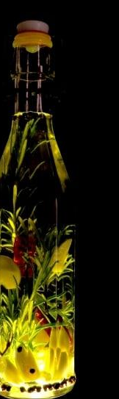
How to make your own macerated oil
Penny Price Academy
Saturday Club
June 2024
The raw material is picked and chopped up. The drier the raw plant material the better
This material is put into a base fixed carrier oil and into an airtight container. Add 5% wheatgerm to help preserve the oil.
This container is then stored in a warm place (traditionally sunny) so windowsills are ideal and frequently stirred for up to three weeks. The sunshine will gently heat the oil and extract many of the plant’s properties.
After about 3 weeks you can then strain off and filter the oil. Place in a fresh airtight jar and use! They will keep for about 2 years.

Slide 27
Some plant suggestions to macerate
Penny Price Academy
Saturday Club
June 2024
Roses
Calendula or marigold flowers
Lavender flowers
Chamomile flowers
Rosemary
Geranium
Orange Blossom

Slide 28
Recommended books
Penny Price Academy
Saturday Club
February 2024
Gabriel Mojay - Aromatherapy for Healing the Spirit: Restoring Emotional and Mental Balance with Essential Oils
Peter Holmes - Aromatica: A Clinical Guide to Essential Oil Therapeutics. Principles and Profiles vols 1 and 2
Salvatore Battaglia - The Complete Guide to Aromatherapy
Julia Lawless - Encyclopedia of Essential Oils
Valerie Ann Worwood - The Fragrant Pharmacy
Kurt Schnaubelt - The Healing Intelligence of Essential Oils

Slide 29
Get 10% Off With Code:
SatClubJune
Geranium
Sage
Thyme ct linalool
Basil ct linalool
Rosemary ct cineole / ct camphor
Cistus/Rock Rose
Roman Chamomile
Carrot Seed
Yarrow

