Slide 1
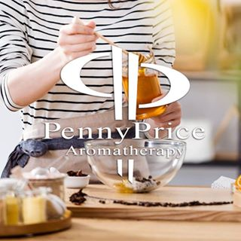
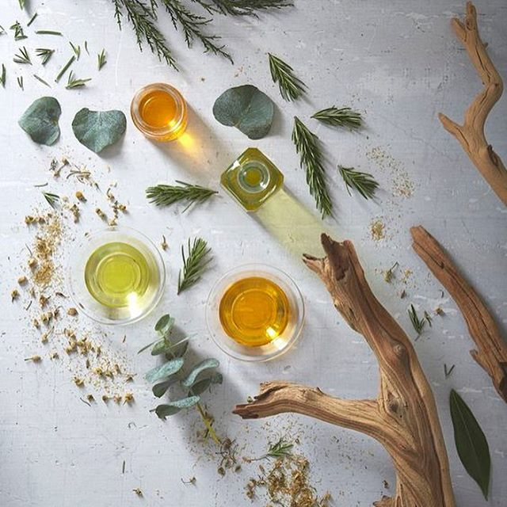
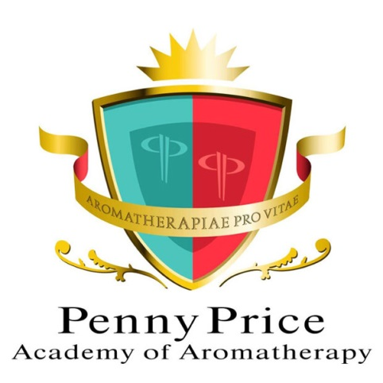
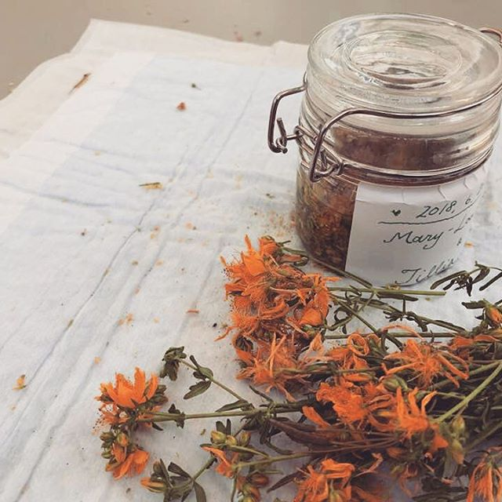
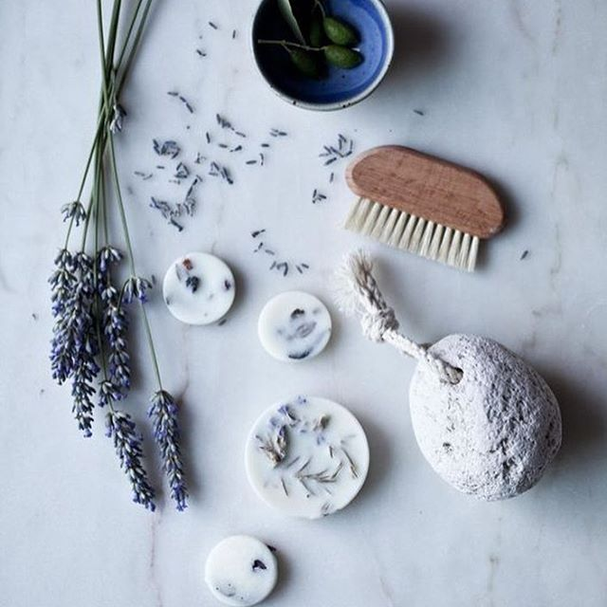
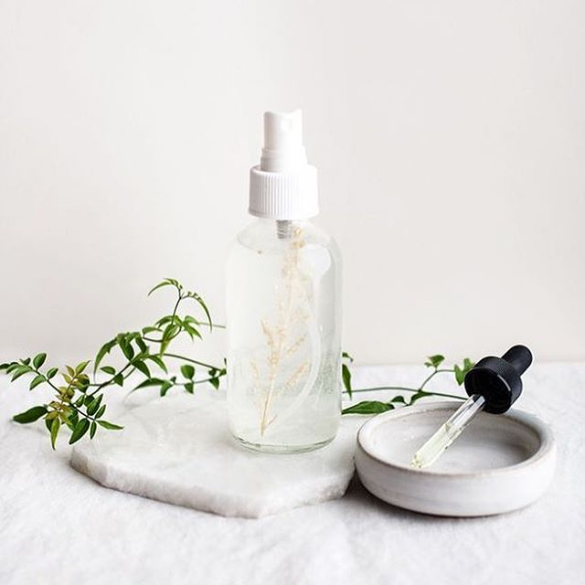
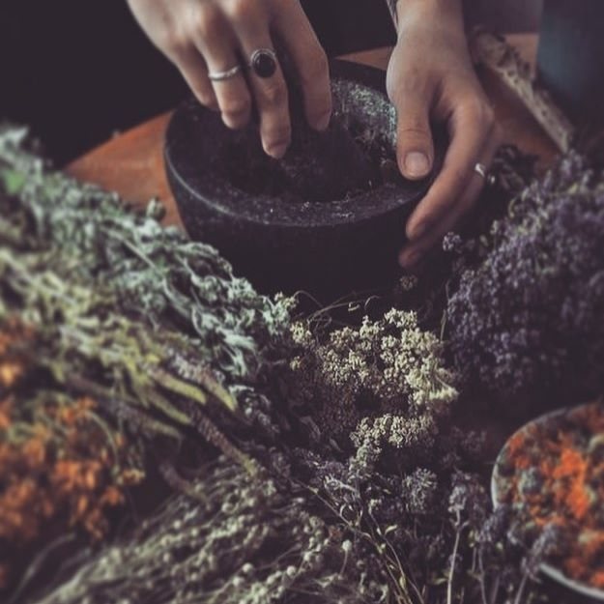
August Saturday Club
Skin Trends

Slide 2
What is a Skin Trend?
Penny Price Academy
Saturday Club
August 2024
The global skincare market size was valued at USD 109.71 billion in 2023 and is projected to grow from USD 115.65 billion in 2024 to USD 194.05 billion by 2032.
A trend is defined as a general direction in which something is developing or changing.
With skin care trends are often started at the roots i.e. the labs who create active ingredients.
Natural skin care trends sometimes have a different take on the mainstream trends.

Slide 3
What effects our skin?
Penny Price Academy
Saturday Club
August 2024
Genetics
Water intake
Sun Exposure Central heating/weather changes
Spicy food/alcohol/smoking/ caffeine etc.
Science (skin care)
Stress
Blue Light i.e. screens

Slide 4
Skincare Routine
Penny Price Academy
Saturday Club
August 2024
A regular skincare routine is key to good skin along with factors such as water intake and diet.
Cleansing takes away grime and build up from the atmosphere whilst toning restores PH and moisturising aids skin health and hydration.
We will be looking at aromatherapy ingredients that can be added into your routine to improve the look of the skin. Remember to incorporate them how they best fit into your routine.
* many over the counter cosmetics have at least 50% mark up on if not more.

Slide 5
Penny Price Academy
Saturday Club
August 2024
Individual Ingredients

Slide 6
Macadamia Carrier Oil
Penny Price Academy
Saturday Club
August 2024
Macadamia nut oil is one of the highest plant derived sources of palmitoleic acid, which protects cell lipids from oxidative damage (Alvarez and Rodriguez, 2000).
Its high content of essential fatty acids, particularly palmitoleic acid and oleic acid, gives macadamia nut oil restructuring properties; it strengthens the skin lipid barrier and thus improves skin moisture content. It has emollient and regenerative properties and is an adequate skin conditioner
This Photo by Unknown Author is licensed under CC BY-SA

Slide 7
Sea Buckthorn Oil
Penny Price Academy
Saturday Club
August 2024
Sea buckthorn contains a high source of vitamin E, vitamin C, unsaturated fatty acids, beta-carotene and essential amino acids.
This oil has been credited to regenerating skin cells, reducing wrinkles and for promoting the healing of skin injuries such as wounds, burns, sunburns and eczema.
Due to it's antioxidant properties, sea buckthorn carrier oil can additionally improve cell metabolism of subcutaneous tissue and fight free radical damage.
This Photo by Unknown Author is licensed under CC BY-NC-ND

Slide 8
Rosehip Carrier Oil
Penny Price Academy
Saturday Club
August 2024
Rosehip oil acts as an emollient. It has been found to be a tissue regenerator and effective at reducing scar tissue. Regeneration of fibroblasts could lead to an increase in skin elasticity and thus have anti-aging effects (Driskell et al., 2013).
Contains small amounts of trans-retinoic acid, a vitamin A derivative (Price, 2008). Rosehip oil also has a high amount of vitamin C.
Rosehip is useful for scars, eczema, burns & skin regeneration.
This Photo by Unknown Author is licensed under CC BY-SA

Slide 9
Rose Essential Oil
Penny Price Academy
Saturday Club
August 2024
The oil is well reputed for it’s efficacy for nervous conditions – palpitations, irritability, insomnia, depression and grief.
Rose otto is also good for the skin which is why it is the focus of so many cosmetics. It helps to soften and hydrate the skin and is most suited to dry, mature and sensitive skin types. It also has an astringent effect on capillaries and some have noted it to be useful for rosaceae.
The perfect oil for self love and to help repair a broken or rejected heart. It can be like a hug in the bottle for emotions.
Also known to be an aphrodisiac and resonates with the heart chakra
This Photo by Unknown Author is licensed under CC BY-SA

Slide 10
Myrrh Essential Oil
Penny Price Academy
Saturday Club
August 2024
Myrrh was traditionally used in Eygpt an array of cosmetic and medicinal processes, from the embalming of mummies to the preparation of skincare treatments for affluent women.
By incorporating Myrrh oil into your skincare routine, you can help reduce the appearance of fine lines and wrinkles, especially when used daily
Used For:
Athletes’ foot
Chapped and cracked skin
Wounds & wrinkles

Slide 11
Cedarwood Essential Oil
Penny Price Academy
Saturday Club
August 2024
Cedarwood oil has anti-inflammatory and antimicrobial properties. This may make it beneficial for skin conditions like acne. (Hassoun et al 2016) conducted case studies and found its efficacy.
Cedarwood has often been cited as being beneficial for other skin conditions. For example, it may reduce the appearance of scars, treat minor wounds, alleviate arthritis pain, and sooth symptoms of eczema.
This Photo by Unknown Author is licensed under CC BY-SA-NC

Slide 12
Neroli Essential Oil
Penny Price Academy
Saturday Club
August 2024
Many facial oils on the market use neroli as their featured ingredient.
Neroli Essential Oil is a hydration powerhouse, with an incredible ability to soften, replenish and lock in moisture.
50% of neroli is composed of Linalol and linalyl acetate which has been shown to be anti inflammatory. The ester content of neroli may explain why it is so balancing to skin.
This Photo by Unknown Author is licensed under CC BY-NC-ND

Slide 13
Hydrolats
Penny Price Academy
Saturday Club
August 2024
Hydrolats include the water soluble molecules from a plant so incorporating them into skincare with EOs gives the whole spectrum of the plant volatiles.
Neroli, rose and lavender smell like their EO counterparts and fit into your skincare routine as a toner.

Slide 14
Other tools
Penny Price Academy
Saturday Club
August 2024
There are many other things we can use from other modalities we do or are aware of to complement homemade skincare.
Facial mapping/reflexology is growing therapy with maps available online.
Facial yoga and/or stretches
Using crystal or natural tools such as jade rollers, Gua Shae tools & lymphatic brushes.

