Slide 1
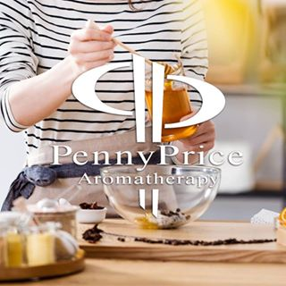
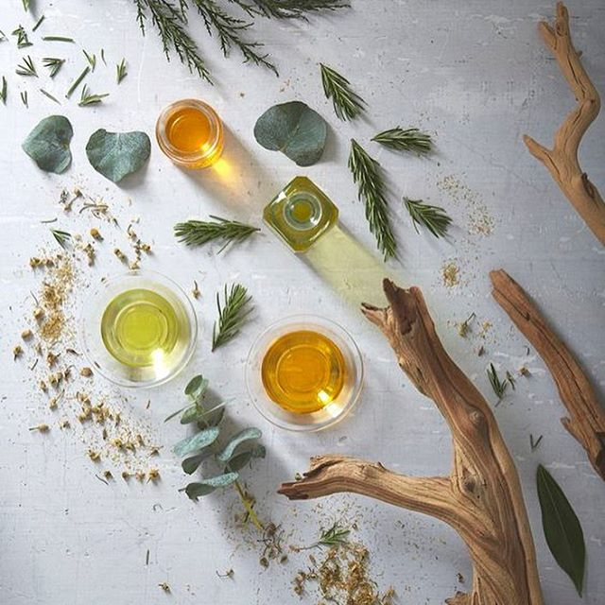
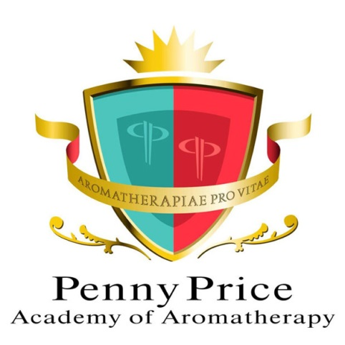
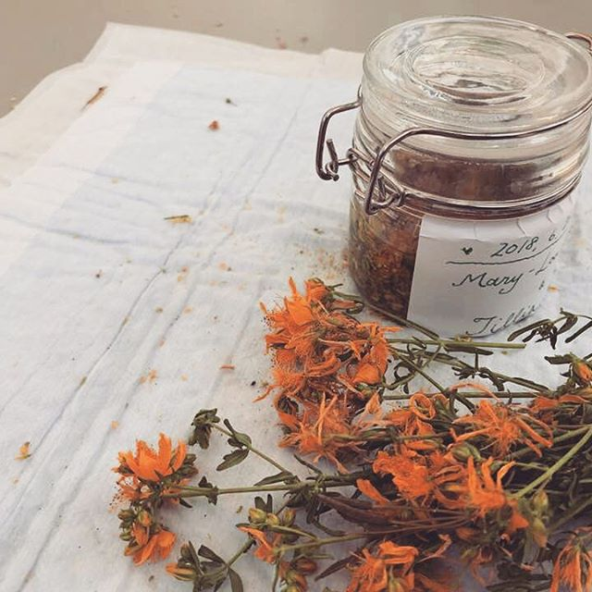
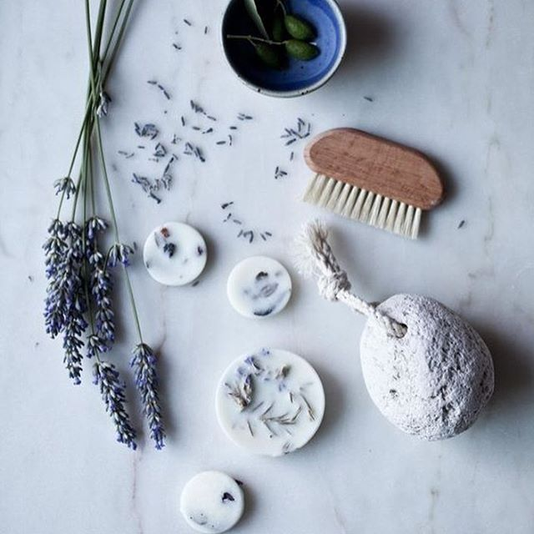
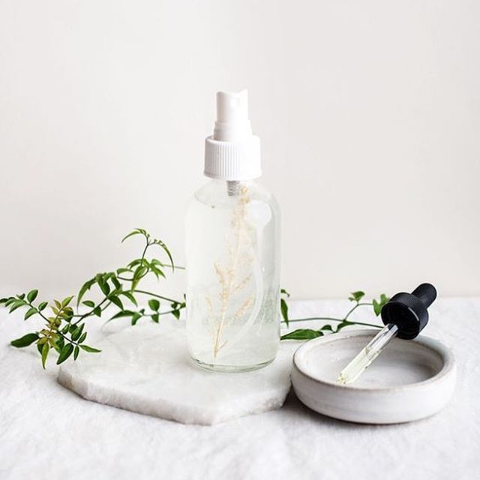
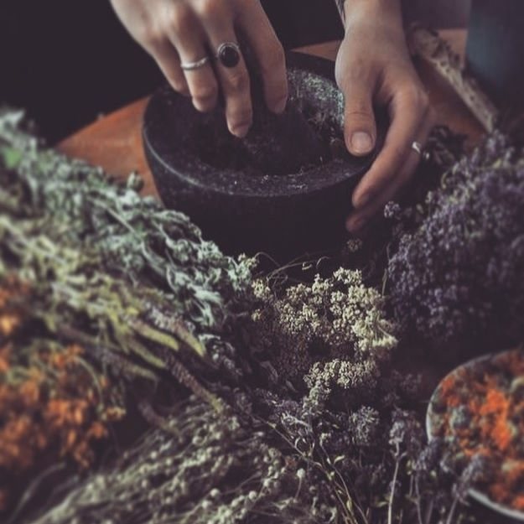
Open Day September 2024
Breath of Life
Nurture Breathing
Reed Diffusers
Wellbeing, World and Work
Presented by
Ellie Dunmore

Slide 2
Wellbeing, World and Work
Penny Price Academy
Open Day
September 2024
Wellbeing
Work / life balance, health, stress management, wellbeing and more!
World
Community Programmes, Volunteering, Corporate social responsibility, charities and more!
Work
Growing business, business challenges, ideas and more!

Slide 3
Penny Price Academy
Open Day
September 2024
RELAUNCH! Our Breathing Lotion and
its Essential Oils!

Slide 4
Nurture Breathing
The Story Behind the oil…
Bob!
Qualified Aromatologist – married to Penny!
Uses 2 drops per day of the Nurture Breathing essential oil in each elbow to help naturally control his asthma
Our biggest customer for this oil!
Penny Price Academy
Open Day
September 2024

Slide 5
The formulation….. An Overview
Eucalyptus, peppermint, lavandin, and hyssop essential oils to help relieve symptoms of asthma, hay fever, bronchitis, and more. A few drops added to your daily bath can help maintain healthy lungs.
Eucalyptus smithii is a gentle essential oil that is a decongesting respiratory and warming oil while Lavandin is decongesting, mucus clearing and sedative.
Peppermint is respiratory, uplifting, mucus relieving and cooling and Hyssop is both a strong oil for the respiratory system and calming.
The Nurture Breathing blend is essential for autumn, winter and spring to keep your respiratory system healthy.
Penny Price Academy
Open Day
September 2024

Slide 6
The oils…. Eucalyptus Smithii is analgesic, anti-catarrhal, anti-infectious, antiviral, decongestant and expectorant. It is useful for coughs, colds, flu, aches and pains, asthma, headaches and stress. It is a powerful air purifier when vaporised. 1,8 cineole 75% - 85%
Penny Price Academy
Open Day
September 2024
Notes:
Penny has spoken to you about this one already ☺

Slide 7
Lavandin is anti-catarrhal, antifungal, antiviral, expectorant, neurotonic and sedative. It is commonly used for bronchitis, candida, athlete’s foot, chronic migraine and enteritis. Mentally, it can be used for nervous debility, listlessness and post- surgery stress as well as being useful for asthma inflammation and pain Lavandin is a clone of Lavandula angustifolia x Lavandula intermedia so has close properties to that of True Lavender. Often used as a cheaper alternative than Lavender True due to it having a more ‘lavender’ smell. 1,8 cineole 2% - 11%
Penny Price Academy
Open Day
September 2024
Notes:
Lavandin oil is a hybrid plant developed by crossing true lavender with spice lavender or aspic Lavender.
So Lavandula angustifolia, True Lavender is crossed with Lavandula spicata, Spike Lavender creating Lavandula X intermedia, Lavandin.
This plant is larger than true lavender with woody stems and purple-blue flowers, which are abundant. Mainly cultivated in France and Spain, Lavandin plants are much bigger than lavender (about 36”), the stems are branched these plants grow best at altitudes below 500 metres above sea level.
Lavandin does not have a long history, but has been used for the last 60 years as a substitute for true lavender as it produces roughly 10x more oil than the Lavender True plant. In fact most of the lavender products you see on the high street today contain lavandin, rather than lavender, due to this high oil yield and its very perfumed scent.
There are no known contra-indications to Lavandin, but it is different to lavender in chemical composition containing up to 48% alcohols and 25% Esters depending on the quality of the hybrid. Lavender True, as a comparison, contains 40/42 Esters and Alcohols and therefore therapeutically it offers different strengths - so please don’t confuse the two!
Lavandin is anti-catarrhal, antifungal, antiviral, helps removal of phlegm and Catarrh, has a strengthening or stimulating effect on the nerves and is a sedative. It is commonly used for bronchitis, candida, athlete’s foot, chronic migraine and enteritis. Mentally, it can be used for nervous debility, listlessness and post-surgery stress
I hope this overview has helped clarify why Lavandin isn’t really a Lavender. More information can be found on our blog (link below!) and, as always, we are always happy to hear from you if you have any questions we can help you with.

Slide 8
Peppermint has a wide range of therapeutic uses and is a versatile essential oil. Some of these properties are: analgesic, anti- inflammatory, anti-migraine, antispasmodic, antiviral, carminative, digestive, expectorant, mucolytic, neurotonic and utero-tonic. Menthol, peppermint’s major constituent, is known to interact with cold receptors in the airways upon inhalation. This is known to reduce the perception of nasal congestion and increase the perception of nasal airflow and has also been found to reduce the discomfort associated with laboured breathing. It is used for migraine, neuralgia, bronchitis, sinusitis, colic, herpes, indigestion, nausea, colitis, IBS, irregular periods, apathy and nervous conditions. 1,8 cineole 3% - 7.4%
Penny Price Academy
Open Day
September 2024
Notes:
Peppermint has a wide range of therapeutic uses and is a versatile essential oil. Some of these properties are analgesic (pain-relieving), anti-inflammatory (reduces inflammation or swelling), anti-migraine (helps with migraines), antispasmodic (relieves muscle tension and spasms), antiviral, carminative (calming to the body and mind), digestive, expectorant (thins and loosens mucus), mucolytic (Mucus clearing), neurotonic (a tonic for the mind) and uterotonic (giving tone for the uterus).
Peppermint essential oil is reportedly a central nervous system stimulant that is supported by animal studies showing an increase in activity of mice upon inhalation of peppermint essential oil compared to no aromas (Dobetsberger and Buchbauer, 2011).
Also, peppermint’s central nervous system stimulating effect on humans was investigated in a study of 44 healthy volunteers. A concealed essential oil diffuser was used to deliver the essential oil via inhalation, and several cognitive parameters were measured in comparison to a control of no aromas of essential oils. The data showed significant increased alertness reported by volunteers using a mood scale were found compared to controls, as well as a significant increase in memory function (Moss et al., 2008). A small trial also reported that peppermint odour acted as a central nervous system stimulant; significantly increasing alertness, motivation, performance and decrease fatigue and frustration in a simulated driving test (Raudenbush et al., 2009).

Slide 9
Hyssop is anti-allergic, anti-infectious, anti-inflammatory, cicatrisant, digestive and emmenagogic. Used to treat bronchitis, asthma, hay fever, coughs and colds, emphysema and influenza. It is effective for bruises, wounds, scars and eczema, loss of appetite, asthma and scanty, irregular periods. Can regulate blood pressure if used under direction and has remained popular throughout the centuries for its ability to treat respiratory conditions such as asthma and sore throats in various medicaments.
Penny Price Academy
Open Day
September 2024
Notes:
A perennial herb about 60cms high with purple-blue flowers. The flowering tops of the plant are used to produce the essential oil.
hyssop has an ancient reputation for use in purification for sacred places and sacred people, and was offered to Jesus on the cross with a sponge of vinegar. It was also used to regulate blood pressure, ease bronchitis and calm anxiety states.
Not normally used on babies, children and the elderly, or on pregnant women. Hyssop has different proportions of chemicals depending on the time of harvest. Traditional harvest will produce an oil high in pinocamhone, whereas if the plant is harvested later in the season, the pinocamphone levels drop dramatically. This latter is the safer oil to use, particularly if a client has slightly high blood pressure.
Hyssop is used as a flavour ingredient in alcoholic drinks and is also a base for eau-de-cologne.

Slide 10
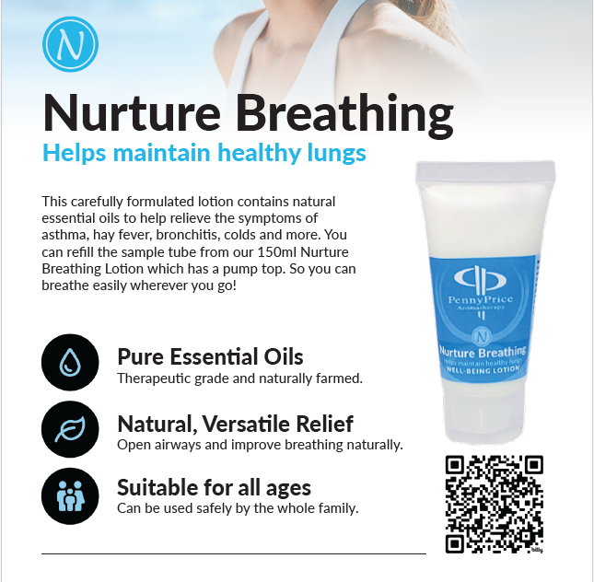
Penny Price Academy
Open Day
September 2024

Slide 11
Penny Price Academy
Open Day
September 2024
New Product and Base!!

Slide 12
Sleep Spray
What’s inside and why?....
Lavender
has been documented as a therapeutic agent as far back as the ancient Greeks and Romans.
Both the dried foliage and essential oil have remained continuously popular as both therapeutic and cosmetic agents to the present day (Cavanagh and Wikinson, 2002).
The plant is commonly purported to have anti-depressant, anxiolytic and sedative properties, thus its essential oil has been used often for relaxation.
Reduction of anxiety can aid in getting to sleep, and there is some evidence to support lavender’s reputed anxiolytic effect.
Penny Price Academy
Open Day
September 2024

Slide 13
Ylang Ylang
With a sweet floral aroma, known for its calming and relaxing effects, it can help uplift the mood, promote a sense of balance and enhance overall well-being. Our Ylang Ylang is distilled in Madagascar for a full 24 hours to obtain what is known as Ylang Ylang Complete. It is traditionally used as an aphrodisiac, anti anxiolytic, sedative and relaxant.
Previous studies have reported that aromatherapy with inhaled essential oils had a positive effect on reducing anxiety and increasing quality of sleep.
The inhalation method of blending oils with lavender, ylang ylang, and bergamot once daily for four weeks reduced blood pressure, pulse, subjective stress, and state anxiety levels of clients with hypertension, as well as reducing nocturnal urination, compared to the placebo and control group, which led to deeper and more satisfying sleep (Hwang, 2006).
Penny Price Academy
Open Day
September 2024

Slide 14
Roman Chamomile
is calming, helps balance the menstrual while easing stress and encouraging sleep. Also known for its gentle and soothing properties, it helps promote relaxation and reduces stress and anxiety.
Massages of Roman chamomile for 20 minutes, 3 times a week were reported to significantly improve self-esteem and decrease the anxiety of cancer patients (Srivastava, Shankar and Gupta, 2010), supporting its use as a relaxant.
Roman chamomile is reportedly spasmolytic, with numerous studies providing evidence for this property.
Penny Price Academy
Open Day
September 2024

Slide 15
Bergamot
is very different chemically from the other expressed essential oils from this family. It is rich in esters and alcohols and is similar to lavender. Used in a study with lavandin and ylang ylang it produced deep sleep with reduced trips to the toilet ( Arzi et al 2010).
The scent of Bergamot is very calming especial for those who are suffering with anxiety. While many essential oils bring a soothing effect, few are as powerful as bergamot.
“Researchers set up oil diffusers in a hospital waiting room where anxiety is exceptionally high. The control group reported a greater sense of calm and higher energy while waiting.” (ReNue Pharmacy, n/d)
“A 2013 article published in the journal ‘Current Drug Targets’ reported that aromatherapy with bergamot can relive depression, anxiety, and other mood disorders by signalling the brain to release dopamine and serotonin.” (Whelan, 2018)
Overall, having this oil in an oil blend has the added benefit of having a calming scent and increase positive mood for an induvial.
Penny Price Academy
Open Day
September 2024

Slide 16
Juniper was referenced in the Bible, inferring its ability to relieve fatigue (Sellar, 1997) This Oil offers emotional support and reduce physical and emotional sighs of stress. Some sources claim that juniper is one of the most effective essential oils for dealing with inner trauma and pains because juniper may have positives effects on relaxation responses in the brain when inhaled. (Levy, 2018) When in use the oil becomes a relaxant and sleep aid as the smell of juniper offers emotional support and reduce physical and emotional signs of stress. When inhaled juniper may have positive effects on relaxation responses in the brain. (Levy, 2018) Overall, this essential oil added to this blend has the added benefit of a relaxant and sleep. Juniper essential oil is effective in nearly all forms of cramps by relaxing the muscles. (Nagdeve, 2021) making this a prefect choice to aid rest.
Penny Price Academy
Open Day
September 2024

Slide 17
Essential Oil Diffuser base
A natural solubilizer with features that enable its application as reed diffuser base, fragrance carrier and/or diluent for fragrances, reinforcing the odour and extending the air fresheners fragrance. It is glycerine based.
IFRA Compliant
Made in the UK
Vegan-Friendly
Cruelty Free
This biobased solvent is derived from a renewable source. It presents excellent solubilization power, adequate evaporation rate, low odour and LVP-VOC, which are key to achieve a sustainable formulation.
Unlike DPM (Dipropylene glycol methyl ether) and other diffuser bases, this evaporates fully and does not have the metallic odour associated with other base materials.
The base can support high levels of essential oils (10-25%).
Penny Price Academy
Open Day
September 2024
Notes:
LVP-VOC =
Low Vapor Pressure Volatile Organic Compounds(LVP-VOCs) means it has low volatility
Volatile organic compounds, are carbon-containing chemicals that easily evaporate into the air at room temperature.
Dipropylene Glycol Methyl Ether is a colorless liquid with a mild and pleasant odor. It is a solvent used in paints, pastes, dyes, resins, brake fluids and inks, and in making cosmetics. It is an organic solvent with a variety of industrial and commercial uses but is a less volatile alternative to propylene glycol methyl ether and other glycol ethers.

Slide 18
How to Use the Base in a Diffuser
What you will need:
A suitable container, glass is ideal as it is does not react with your mixture. 2. Enough Essential oil synergy to add 10 to 25%
3. Essential Oil Diffuser base
4. 5-10 reeds depending on the size of your container.
Instructions:
For our example of a reed diffuser in a 200ml bottle at 10% we are going to first add 180ml of Essential Oil Diffuser base to a jug, followed by 20ml of your chosen oil synergy
It is preferable to mix in a jug so if you choose to make more than one reed diffusers at a time the mixture will be consistent.
Once you have your mixture, you simply need to fill your container and add the reeds. Place them into the neck of the bottle and into the reed diffuser mixture, allow them a short time to absorb some fragrance. Then carefully remove the reeds flip them over and place them back into the reed diffuser.
Now you are ready to enjoy your own handmade reed diffuser.
Penny Price Academy
Open Day
September 2024
Notes:
You could re-use an old reed diffuser bottle or you can buy new bottles if you are buying a new bottle you will also need to buy a cap.
You can add a colour to your base using natural food dye if you would like to make a clear bottle look pretty.
If you have used your own container, and the reeds are to large you can trim them to make the diffuser more stable. Ensure when filling the bottles you leave room for the reeds to be added so you don’t overfill. You may find the use of a small funnel helpful for this job.

Slide 19
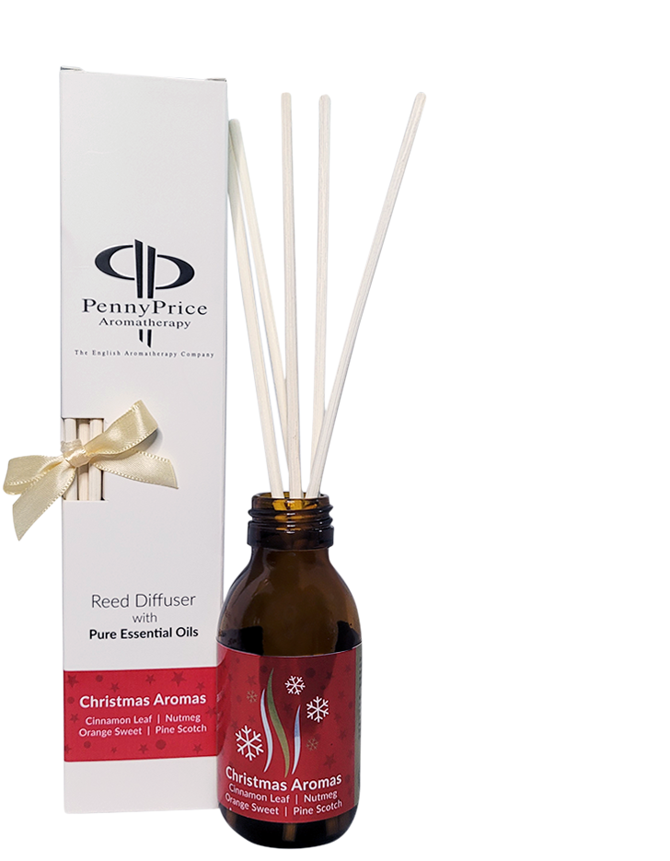
Christmas Oil Diffuser
Christmas Aromas essential oil synergy
10% essential oil in Essential Oil Diffuser Base
5 Reed diffuser Stick
Amber glass bottle with Aluminium lid
Fill Your Home with that Warm, Festive Feeling!
Imagine the cosy aroma of a crackling fireplace, the fresh scent of pine trees, and the comforting embrace of holiday spices—all neatly packaged in a diffuser bottle. It's the perfect way to give your home that warm, festive feeling!
Warm and inviting aromas: The blend of cinnamon, sweet orange, pine scotch, and nutmeg creates a cozy and festive atmosphere.
Long-lasting fragrance: The diffuser will fill your home with fragrance for weeks.
Beautiful Christmas Gift! Make your own!
Penny Price Academy
Open Day
September 2024

Slide 20
Wellbeing, Work and World
Use the boards
Support each other
Information will be shared!
Nurture Mobility
Give your samples out and feedback to us
Don’t forget your professional discount applies!
Sleep Spray and Essential Oil Diffuser base
New Product
Let us know your thoughts
Any suggestions?

