Slide 1
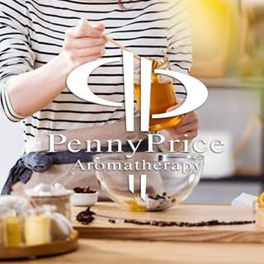
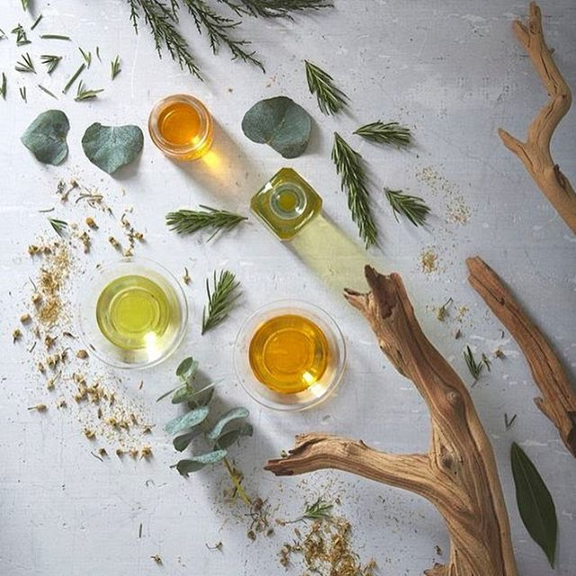
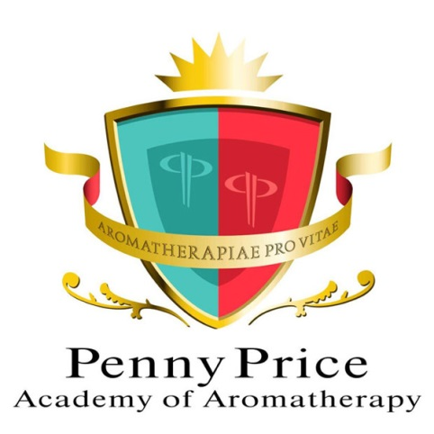
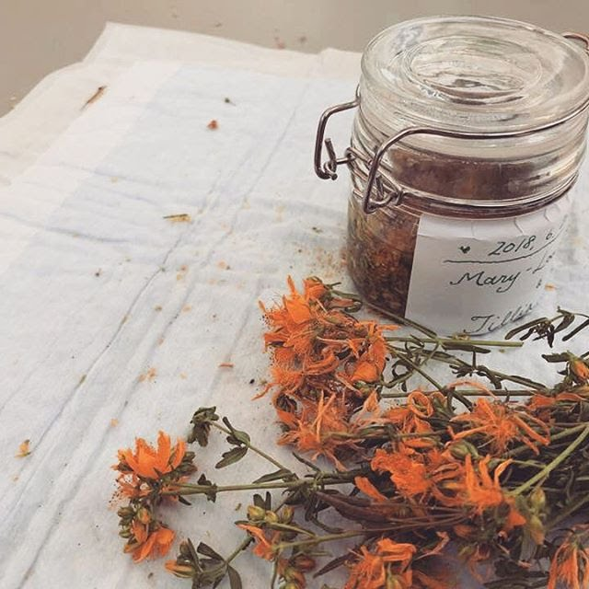
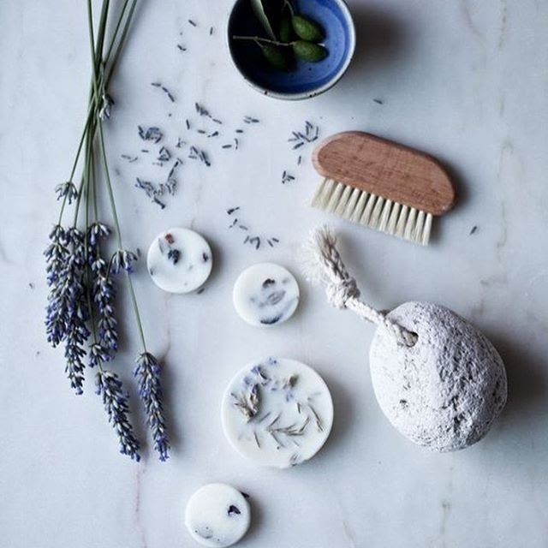
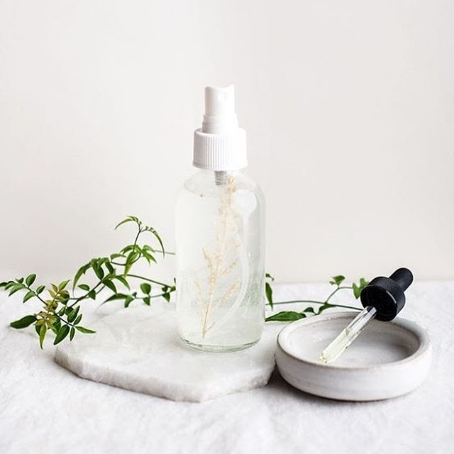
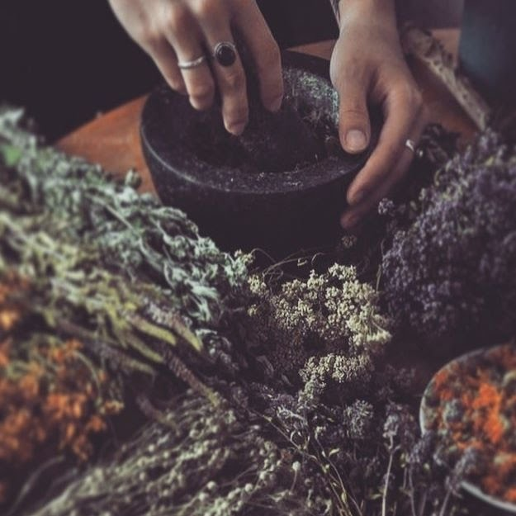
Welcome to…
Penny Price Academy
of Aromatherapy
Saturday Club
Supporting Children’s Mental Health with Essential Oils

Slide 2
Benefits of Aromatherapy on Mental Health
Penny Price Academy
Saturday Club
October 2024
Oils are inhaled whenever you use them. When they
are inhaled :
Some molecules enter the nose and attach to the olfactory bulb, the olfactory nerves connect directly to the brain and impact the amygdala, the emotional centre of the brain.
Inhalation via the nasal passages is indisputably the quickest effective route in the treatment of emotional problems as the nose has direct contact with the brain.
Don’t forget babies and children have a powerful sense of smell.

Slide 3
Essential oils can help with issues such as:
Penny Price Academy
Saturday Club
October 2024
Anxiety
Depression
Insomnia
Stress
Physical issues arising from stress
Anger
Eating disorders
PTSD
It allows the child can take back some control over their own health. It gives them a tool to help support their own emotions and bodies.

Slide 4
How can we support children with mental health issues?
Penny Price Academy
Saturday Club
October 2024
A listening ear but only if they want to talk
No judgment
Support
Kindness
Be gentle, calm and slow any massage movements
Play calming music if they are happy to listen to it

Slide 5
Protocols for treating young people
Penny Price Academy
Saturday Club
October 2024
Always obtain the permission of the child’s guardian before attempting any treatment
Remember inhaling essential oils is one of the most powerful ways of affecting the emotions
An hand, foot or seated massage through clothes is recommended
They (and you!) may feel more comfortable to have an adult present during treatment or just outside the door

Slide 6
Remember children have sensitive skin
Penny Price Academy
Saturday Club
October 2024
Recommended dilutions for children’s skin:
In carrier oil - in 10ml of almond or sunflower oil use 1 drop for babies up to 3 years old, use 2 drops for 4-7 years old.
In lotions and creams - in 10ml use 1 drop for babies up to 3 years old, use 2 drops for 4-7 years old.
In baths - Add 1 drop in a baby bath, with bath foam to disperse for babies up to 3 years old, use 2-3 drops of 4-7 years old.

Slide 7
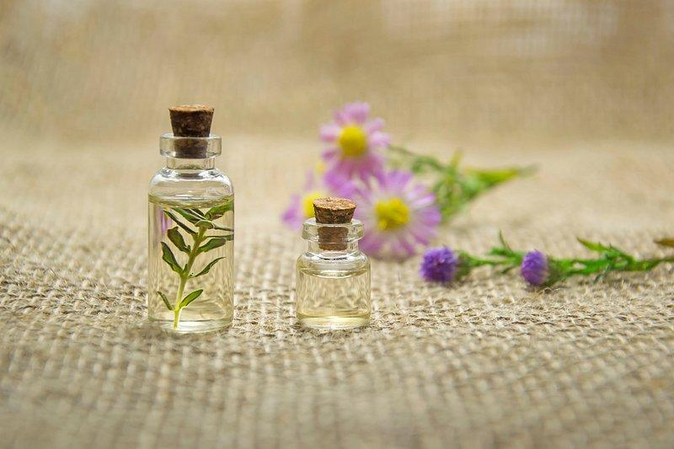
The Essential Oils
Penny Price Academy
Saturday Club
October 2024

Slide 8
Mandarin
(Citrus reticulata)
Penny Price Academy
Saturday Club
October 2024
Known as the children’s remedy because it is so gentle but also children love the aroma.
The oil contains a small amount of an ester, anthranallic acid which is highly sedative and very gentle. This makes it the first choice for children suffering with anxiety, nervousness or stress. It is said to be good for mood swings and irritability where it is stabilising and calming.
It is also excellent for insomnia especially when due to stress

Slide 9
Mandarin
(Citrus reticulata)
Penny Price Academy
Saturday Club
October 2024
Mandarin’s actions are very similar to Bergamot essential oil, it is uplifting and cheerful but in addition, Peter Holmes says it is able to infuse light to dark, negative, hardened or morbid thoughts.’
He recommends it for depression with anxiety where Mandarin will uplift and calm.
Patricia Davis describes how mandarin breathes a message of happiness to children.

Slide 10
Roman Chamomile
(Anthemis nobilis)
Penny Price Academy
Saturday Club
October 2024
A very gentle oil, Roman chamomile is soothing, calming and an antidepressant and particularly helpful where stress and anxiety cause a child to be fretful, irritable or nervous.
The oil is effective in calming down annoyance, anger and irritation particularly in small children.
It is said to help to relax and diffuse tension at its root and can act as a hypnotic for acute stress-related conditions.
Physically, its actions mirror its psychological effects helping with tension headaches, nervous digestive problems (nausea, bowel issues etc).

Slide 11
Roman Chamomile
(Anthemis nobilis)
Penny Price Academy
Saturday Club
October 2024
Peter Holmes suggests that when inhaled, chamomile can help dissolve negativity and resolve anger issues.
Valerie Worwood describes chamomile as harmonising, peaceful and soothing to the spirit.
Gabriel Mojay points out that ‘chamomile is of greatest benefit for problems associated with a build up of tension in the solar plexus. When in this condition, our emotional needs and wants have usually intensified and if they are frustrated, we can become vexed and irritable. ‘

Slide 12
Lavender
(Lavendula augustifolia)
Penny Price Academy
Saturday Club
October 2024
Physically, Lavender is useful for headaches and insomnia which both can arise from stressful situations.
There have been several studies looking into the use of lavender for PTSD. A 2012 study found that the majority of the 50 patients they treated with lavender showed an improvement in the symptoms of PTSD,
Mojay suggests that ‘lavender calms and stabilises and can ease nervous tension and allay feelings of panic and hysteria. It helps to release pent-up energy and so eases frustration and irritability.’

Slide 13
A calming blend for anxiety
Penny Price Academy
Saturday Club
October 2024
This blend is not only calming but is perfect if the child is feeling overloaded.
Make up a nasal inhaler (6-10 total drops of essential oils) or a roller ball ( 3-6 total drops of essential oils to 10 mls of carrier oil) to apply to pulse points,
Mandarin - a sedative but also uplifting
Chamomile - gentle and soothing, helpful where stress and anxiety cause a child to be fretful, irritable or nervous
Lavender - calming and balancing

Slide 14
Puberty and mental health
Some of the changes that occur during puberty can leave young people open to being more susceptible to stress.
The hormonal changes they are going through affect things like sleep regulation, irritability, decreased concentration and mood changes.
In this state a young person could find they are more sensitive to stressors in their environment.
The effects of stress can be seen in increased irritability, anxiety or complete withdrawal.
Penny Price Academy
Saturday Club
October 2024

Slide 15
Ylang Ylang
(Cananga odorata)
Penny Price Academy
Saturday Club
October 2024
Ylang Ylang exerts a regulating action on the hormonal system. This feminine oil is also useful for treating symptoms of PMS.
Ylang ylang is an excellent oil for anxiety where it can help the physical symptoms by slowing the heart rate and breathing and the emotional symptoms by cooling and calming.
It is good for relaxation and mood adjusting and stabilising, it is also calming, sedating, relaxing and yet uplifting.

Slide 16
Ylang Ylang (Cananga odorata)
Penny Price Academy
Saturday Club
February 2024
Patricia Davis suggests that Ylang Ylang can be useful when someone is frightened as well as anxious making it an excellent oil around exam time or when there is a big challenge ahead.
Holmes recommends it for ‘acute intense emotions, emotional shock and any intense negative feelings including anger, hatred, deep despair and self destructiveness.’

Slide 17
Geranium
(Pelargonium graveolens)
Penny Price Academy
Saturday Club
October 2024
In girls, if some of the mental health issues seem to be linked with puberty and menstruation, Geranium may be the right choice.
Its cooling action will calm anxiety at all times but its hormone regulating properties will particularly help with PMS.
It blends well with bergamot in times of stress.
Gabriel Mojay suggests that it can give a feeling of calm strength and security and therefore, is beneficial for both chronic and acute anxiety, particularly when the stress is due to overwork perhaps because of exams.

Slide 18
Vetiver
(Vetiveria zizanoides)
Penny Price Academy
Saturday Club
October 2024
The ‘oil of tranquility’, vetiver is recommended for physical, mental and emotional burnout. Its cool energy can help sedate and restore making it an ideal oil for calming an overanxious child who feels overwhelmed.
Mojay describes how it can ground us and help with mental exhaustion.
It is reputed to effectively diminish feelings of anger, irritability, panic and restlessness.
Davis recommends Vetiver as a protection against oversensitivity.

Slide 19
Vetiver
(Vetiveria zizanoides)
Penny Price Academy
Saturday Club
October 2024
Vetiver is also another oil which can help with balancing hormones. It seems to have a regulating action on progesterone and oestrogen production.
It is also said to be able to help with states of disconnection when the person becomes prone to mental and emotional instability, anxiety and agitation.
Peter Holmes states that Vetiver can help in cases of repetitive thinking, obsession, compulsion and other anxiety states.

Slide 20
A blend for balancing hormones
Add a total of 6 drops of any of the following essential oils to 20 mls cream base or 20 mls of carrier oil
Ylang Ylang - calming, sedating, balances hormones
Geranium - regulating, good for PMS
Vetiver - regulating, calming
Also Rose is useful for issues linked to hormones, as it has an affinity with the female reproductive system.
Thyme oil has been found to help balance progesterone
Penny Price Academy
Saturday Club
October 2024

Slide 21
Rose
(Rose damascena)
Penny Price Academy
Saturday Club
October 2024
Rose oil is said to boost self esteem, confidence and mental strength.
Perfect for balancing the emotions, it is a powerful antidepressant used in situations where there has been a lot of stress, anxiety or grief.
Rose is also useful for issues linked to hormones, as it has an affinity with the female reproductive system.
“Bringing warmth to a soul grown cold through abuse or hurt, rose oil can touch the deepest despair, restoring the trust that makes it possible to love again” (Mojay)

Slide 22
Helichrysum (Helichrysum italicum)
Penny Price Academy
Saturday Club
February 2024
Helichrysum has strong restorative and balancing actions on both the body and mind.
It is said to be good for shock, anxiety and intense emotions.
Holmes suggests that that Helichrysum is emotionally calming, softening and stabilizing ‘helping one cope with deep frustration and long bottled up resentment’.
He adds that ‘it can potentially heal the core emotional trauma from which distressed feelings and negative emotions arise…. It is the prime remedy for the closed and deeply wounded heart whether from loss, betrayal or any other cause.’

Slide 23
Patchouli
(Pogostemon cablin)
Penny Price Academy
Saturday Club
October 2024
Patchouli has a harmonising and stabilising effect on the mind helping a child who overthinks and worries too much.
It is a beautiful oil for boosting confidence and is known to help ground people if they are feeling disconnected. Therefore it is useful for a child who due to past traumas feels destabilsed and isolated.
It has relaxing mind-calming properties that help all types of emotional issues.
Davis suggests that Patchouli is helpful for all forms of depression, anxiety and stress related conditions.

Slide 24
A blend for deep unhappiness and trauma
Research suggests a warm bath or shower an hour or two before bedtime can help a person unwind and fall asleep faster as it will help lower core temperature which is a circadian sleep signal.
To 10 mls of unperfumed foam bath add a total of 4-7 drops of:
Rose - balancing, helpful if abuse or trauma has taken place
Helichrysum - helps one cope with deep frustration and long bottled up resentment
Patchouli - useful for a child who due to past traumas feels destabilsed and isolated.
Penny Price Academy
Saturday Club
February 2024

Slide 25
Clary Sage (Salvia sclarea)
Penny Price Academy
Saturday Club
February 2024
Clary Sage is above all a balancing oil, it is strengthening and yet relaxing so ideal when stress or depression arise.
Peter Holmes describes clary sage as calming, stabilising and tonifying. He says that ‘it has a softening effect that can help dissolve any unnecessary hard protective structures’ that we may build up.
He also suggests using this oil for ADHD and PTSD because it has such a calming effect on the limbic system .

Slide 26
Clary Sage (Salvia sclarea)
Penny Price Academy
Saturday Club
February 2024
This oil is recommended for mental and nervous fatigue. It has been described as warm and lively
Mojay describes how Clary Sage ‘is indicated in particular for nervous anxiety and depression characterised by changeable moods, indecision and emotional confusion.
Holmes describes how its ‘sweet fragrance energy fosters emotional stabilization, and its green energy provides calm’.

Slide 27
Bergamot (Citrus bergamia)
Penny Price Academy
Saturday Club
February 2024
Bergamot oil is cooling, refreshing and uplifting.
It is excellent for stress and depression. Many people find the fragrance is reminiscent of summer and therefore it can be useful for treating SAD.
Bergamot seems to appeal to both males and females.
It has been described by Peter Holmes as exceptionally harmonising and balancing and he suggests its use for conditions such as bipolar and ADHD as well as mood swings. He also suggests that this is a useful oil to help break bad habits and treating addictions.

Slide 28
Bergamot (Citrus bergamia)
Penny Price Academy
Saturday Club
February 2024
Jean Valnet suggested that Bergamot might be useful for loss of appetite and consequently Davies felt that this together with its powerful antidepressant properties ‘seems to indicate a valuable possibility for helping in anorexia nervosa’.
Mojay suggests that Bergamot is good for ‘tension, irritability and frustration.’
Davies goes on to describe how she used it for compulsive eaters as it seems to regulate the appetite.

Slide 29
A blend to help with stress
For stress I would suggest a roller ball ( 3-6 total drops of essential oils to 10 mls of carrier oil), a nasal inhaler (6-10 total drops of essential oils) or make up a blend using 10 mls of carrier oil or white lotion and to this add one drop of any 3 of the following:
Clary Sage - good for nervous anxiety and balancing
Ylang Ylang - anxiety and intense emotions
Bergamot - uplifting and good for stress
Penny Price Academy
Saturday Club
October 2024

Slide 30
Recommended books
Penny Price Academy
Saturday Club
February 2024
Gabriel Mojay - Aromatherapy for Healing the Spirit: Restoring Emotional and Mental Balance with Essential Oils
Peter Holmes - Aromatica: A Clinical Guide to Essential Oil Therapeutics. Principles and Profiles vols 1 and 2
Salvatore Battaglia - The Complete Guide to Aromatherapy
Valerie Ann Worwood - The Fragrant Mind
Patricia Davies - Aromatherapy an A-Z

Slide 31
Get 10% off with code
SatClubOctober
Thank you for Attending!

