Slide 1
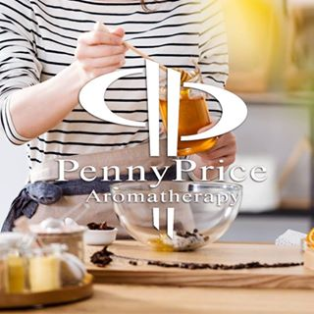
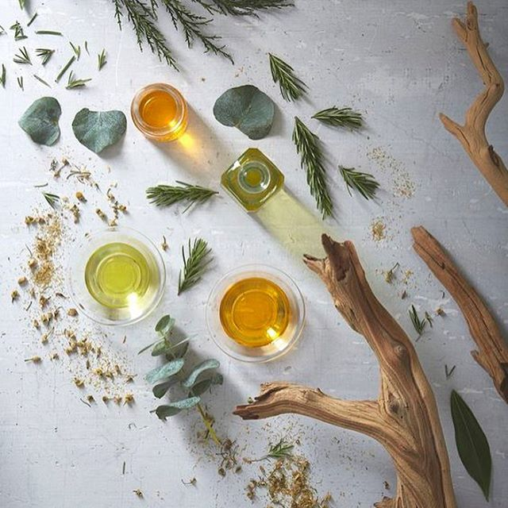
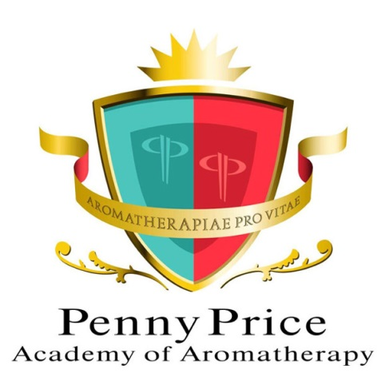
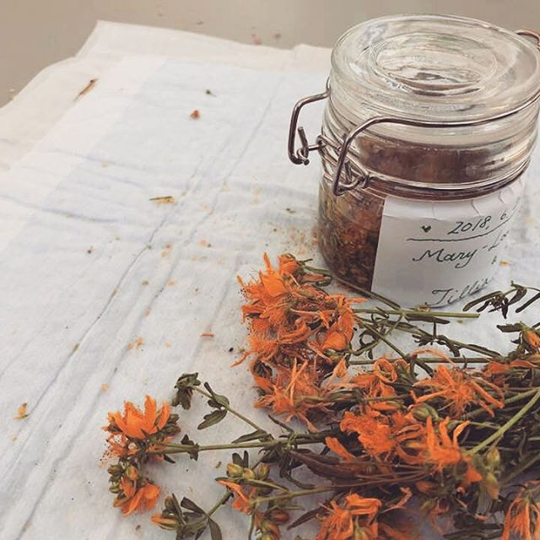
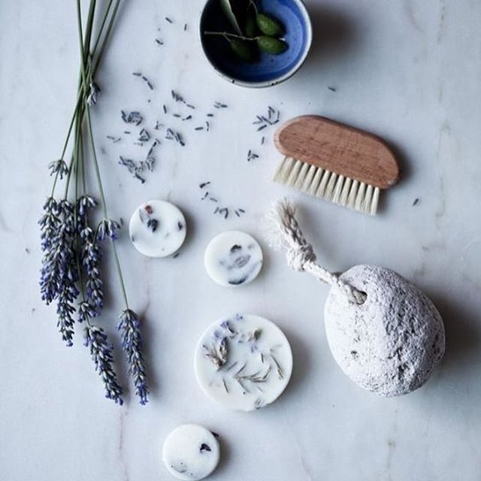
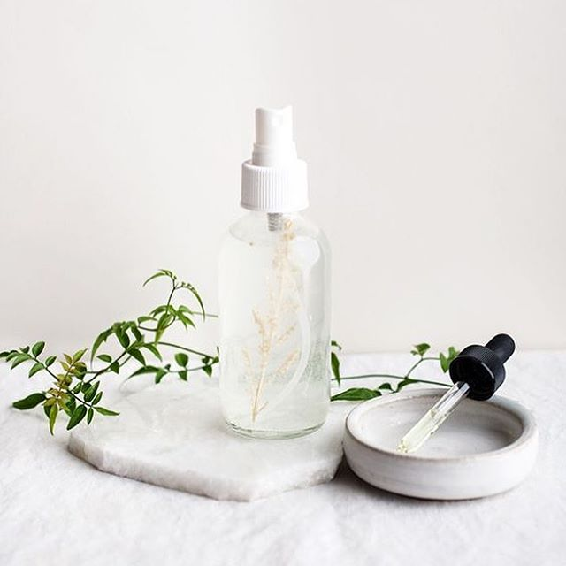
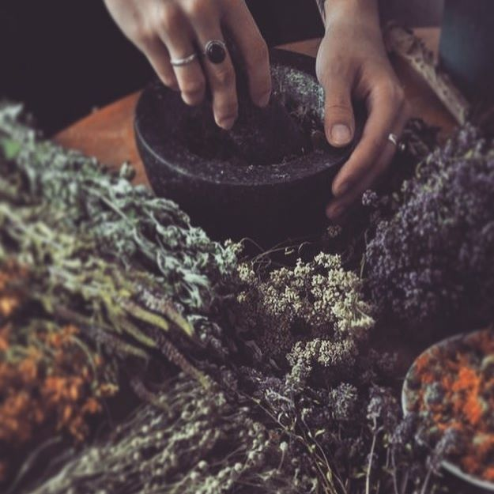
Saturday Club
9th November 2024
Men's Health
Ellie Dunmore

Slide 2
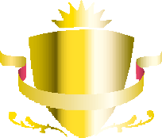
Some of the top health concerns for men include:
Penny Price Academy
Saturday Club
November 2024
Cancer: Prostate, lung, and colorectal cancers are common in men
Heart disease
Alcohol
Respiratory diseases
Testicular problems
Obesity
Vision and hearing loss
Baldness and beard growth
Benign prostatic hyperplasia (BPH
Notes:
Cancer: Prostate, lung, and colorectal cancers are common in men. Prostate cancer is a slow-growing disease that usually appears later in life.
Heart disease: Risk factors include high blood pressure, high cholesterol, and obesity.
Depression and suicide: Men are four times more likely to commit suicide than women. Depression can be underdiagnosed in men, who may show signs of depression differently than women.
Alcohol: Drinking can increase the risk of developing several cancers, including colon, esophageal, liver, oral, prostate, and throat cancer.
Respiratory diseases: Smoking can increase the risk of lung cancer and chronic obstructive pulmonary disease (COPD).
Testicular problems: It's important to regularly examine your testicles for lumps. A common problem is a swelling caused by fluid around the testicle, called a hydrocele.
Obesity: A BMI of 30 kg/m² or higher indicates obesity. Obesity is associated with a number of health problems, including increased risk of heart disease, stroke, type 2 diabetes, and several cancers.
Vision and hearing loss: Men over 40 may experience vision changes such as presbyopia, glaucoma, cataracts, and age-related macular degeneration.
Baldness and beard growth: These can cause anxiety and depression in men.
Benign prostatic hyperplasia (BPH): A non-cancerous enlargement of the prostate.

Slide 3
From Google…
Penny Price Academy
Saturday Club
November 2024
Some common mental health concerns for men include:
Depression
Anxiety disorders
Post-traumatic stress disorder (PTSD)
Substance abuse
Eating disorders
Schizophrenia
Postnatal Depression
Other stressors that can contribute to reducing men's mental health include: Lack of purpose or meaning in life, Loneliness, Relationship problems with spouse/romantic partner, Difficulties at work, and Finance strain.
Notes:
Some common mental health concerns for men include:
Depression: A persistent low mood that can interfere with daily life
Anxiety disorders: Intense and uncontrollable feelings of fear and worry, such as panic disorder, obsessive-compulsive disorder (OCD), generalized anxiety disorder (GAD), social anxiety, and phobias
Post-traumatic stress disorder (PTSD): Approximately 60% of men experience at least one trauma in their lives
Substance abuse: Men are more likely to exercise at the gym to cope with feeling worried or down
Eating disorders: Men account for about 10% of patients with bulimia or anorexia
Schizophrenia: A severe condition where people do not interpret reality as it is
Postnatal depression: 25% of new dads experience depressive symptoms, with 10-12% receiving a diagnosis of depression during the first year after their child is born
Other stressors that can contribute to reducing men's mental health include: Lack of purpose or meaning in life, Loneliness, Relationship problems with spouse/romantic partner, Difficulties at work, and Finance strain.
Men are less likely to be diagnosed with mental health disorders than women, but nearly four times as many men as women die by suicide.

Slide 4
Spotting the signs of mental health issues in men
Penny Price Academy
Saturday Club
November 2024
Persistent sense or worry.
Overwhelming feelings of sadness.
Withdrawal from friends and family.
Difficulty concentrating.
Feeling tired or fatigued.
Physical symptoms like shortness of breath or headaches.
Notes:
There are others
A lot to cover in just one hour, so as I have a husband, 2 teenage sons, 6 brothers, 3 brothers-in-law’s, 7 uncles, 2 ‘dads’, a grandad and a partridge in a pear tree - thought I would choose problems I had helped with!

Slide 5
Anxiety – Black Spruce
Penny Price Academy
Saturday Club
November 2024
Is one of the most common mental health problems for males of ALL ages.
High in bornly acetate, a chemical component that promotes relaxation and calmness
Relaxing and calming to the emotions.
Helps reduce and manage stress.
Promotes feeling of clear and easy breathing.
Soothes minor skin irritation
Soothing relief to the skin
Notes:
Historically used by Native Americans to promote skin health and as part of their spiritual healing and cleansing practices. Black Spruce oil is a powerful wood essential oil, known to create a relaxing atmosphere. Black Spruce essential oil is high in bornly acetate, a chemical component that promotes relaxation and calmness. (Doterra, n/d) As Black Spruce essential oil helps soothes minor skin irritation, this oil will help soothe any razer burns/cuts.
Black Spruce Essential Oil is made from the leaves and twigs of the coniferous evergreen trees. This oil has a warm, sweet, fresh balsamic, slightly sweet coniferous aroma with fruity-resinous undertones. This oil can be useful for soothing skin conditions such as eczema and it is also calming for outbreaks caused by hormone imbalance or stress. It can also help treat or prevent infections in wounds and sores. (Metcalfe, 2017)

Slide 6
Stress – Ylang ylang
Stress is a well-known trigger for depression
affect physical health
Important brain chemicals affected by stress are: serotonin, dopamine, noradrenaline, g- aminobutyric acid, glutamate and corticotropin-releasing factor
Essential oils from plants and flowers have the potential to reduce stress by helping to balance the whole body in order to regularise over and under-reactions to stressful situations
Ylang-ylang oil has commonly used in aromatherapy through either massage or inhalation for relaxation and mood adjusting
Penny Price Academy
Saturday Club
November 2024
Notes:
Stress is a well-known trigger for depression, and it can also affect physical health. Some common signs of too much stress include increased irritability, heightened sensitivity to criticism, signs of tension (such as nail-biting), difficulty getting to sleep and early morning waking (irregular sleep patterns), indigestion and loss of concentration and short-term memory.
Important brain chemicals affected by stress are serotonin (involved in the regulation of sleep, appetite and mood), dopamine (part of the brain’s reward system), noradrenaline (involved in regulating energy and drive), g- aminobutyric acid (GABA: general sedative effect), glutamate (tending to activate nerve cells) and corticotropin-releasing factor (CRF: increases steroid levels). Essential oils from plants and flowers have the potential to reduce stress by helping to balance the whole body in order to regularise over and under-reactions to stressful situations. Certain essential oils, such as lavender, ylang ylang, geranium and bergamot, are well known for this ability.
Ylang-ylang oil has commonly used in aromatherapy through either massage or inhalation ways for relaxation and mood adjusting (Ali et al., 2015.). It could also be used to reduce blood pressure (Hongratanaworakit and Buchbauer, 2004) and improve cognition and mood (Moss et al., 2008) on healthy participants through inhalation way. It also shows an anxiolytic effect on mice in several behavioural tests based on the instinctive responses to novel environments (Zhang et al., 2016).
Statistical analyses revealed that compared to control condition both ambient odours of orange and lavender reduced anxiety and improved mood in patients waiting for dental treatment. These findings support my deep and long held opinion that odours are capable of altering emotional states.

Slide 7
Headache relief - Peppermint
Penny Price Academy
Saturday Club
November 2024
Peppermint’s analgesic and antispasmodic properties have long been used to relieve headache and sinus pain
Applied topically peppermint can dilate blood vessels, which produces a cooling effect.
Peppermint can be applied in a compress to the forehead and back of the neck
Peppermint oil naturally cleanses the skin and has antiseptic and antibacterial properties – good for Acne
rich source of Vitamin A and C and contains folates and omega 3 fatty acids
Notes:
Headache relief
Peppermint’s analgesic and antispasmodic properties have long been used to relieve headache and sinus pain, plus muscle aches. Applied topically peppermint can dilate blood vessels, which produces a cooling effect.
In one study, when peppermint and eucalyptus were applied topically to large areas of the forehead and temples it increased cognitive performance and produced a muscle-relaxing and mentally relaxing effect. It also produced an analgesic effect causing the greatest decrease in headache pain.
Peppermint can be applied in a compress to the forehead and back of the neck. Inhalations, via a diffuser or burner may also be helpful. For quick action try dabbing a drop of peppermint onto each temple (ensure a skin check has been done if using neat). For larger areas or for massage make sure to dilute in a carrier oil.
Anti-inflammation
Anti-acne
Peppermint oil naturally cleanses the skin and has antiseptic and antibacterial properties. It has a cooling effect which soothes irritation and inflammation due to acne," said Dr. Debra Jaliman, a New York City-based dermatologist, assistant professor of dermatology at the Icahn School of Medicine.
Due to its antimicrobial properties, peppermint oil may help reduce levels of acne causing bacteria on the skin to help treat pimples.
Also, Peppermint is a rich source of Vitamin A and C and contains folates and omega 3 fatty acids which help in fighting sun related problems like suntan and sun burn.

Slide 8
Hair & Memory loss - Rosemary
Penny Price Academy
Saturday Club
November 2024
Rosemary is often used in aromatherapy to treat debility and fatigue, and to ‘clear the mind’.
The best way to use rosemary oil (CT cineole) is to apply 1 drop to the inside of each wrist every morning and rub the wrists together. The oil can also be used in the bath and in vaporisers, or in a chest rub.
There is some evidence that a combination of essential oils applied topically may stimulate hair growth in people with alopecia areata
2.5mls of each of thyme, rosemary, lavender and cedarwood into a 10ml bottle, and using 10 drops a day in coconut oil to massage into the scalp.
Notes:
Focus/Memory
Rosemary is often used in aromatherapy to treat debility and fatigue, and to ‘clear the mind’. These properties suggest that rosemary is a central nervous system stimulant. Central nervous system stimulants can enhance alertness, awareness, wakefulness, endurance, productivity and motivation.
In a small human study on 20 volunteers, significant increases in autonomic nervous system parameters of heart rate, blood pressure and breathing rate was found upon inhalation of rosemary oil, giving evidence of a stimulating effect for rosemary. Further support for the stimulating effects comes from the subjective assessment of mood in the study. Subjects reported feeling significantly more alert, active and fresher upon inhalation of rosemary compared to controls (Sayorwan et al., 2012). Moss et al. (2003) found rosemary oil to significantly affect the cognitive performance of participants, in agreement with its stimulant effects and traditional use. In a computerised cognitive assessment, there was a significant increase in quality of memory and long-term memory factors.
The best way to use rosemary oil (CT cineole) is to apply 1 drop to the inside of each wrist every morning and rub the wrists together. The oil can also be used in the bath and in vaporisers, or in a chest rub.
Hair loss
There is some evidence that a combination of essential oils applied topically may stimulate hair growth in people with alopecia areata. In one study participants massaged either an essential oils blend, or a non-treatment oil into their scalps each night for 7 months. The results showed that 44% of those in the treatment group experienced new hair growth compared to only 15% of the control group. The treatment oil contained essential oils of thyme, rosemary, lavender and cedarwood, in a base of grape seed and jojoba oils (Hay, 1998).
2.5mls of each of thyme, rosemary, lavender and cedarwood into a 10ml bottle, and using 10 drops a day in coconut oil to massage into the scalp. The massage should be firm, to the point where the skin of the scalp is moving over the bone, rather than just the fingers moving over the scalp. If you can continue the massage for at least 2 minutes every day an improvement will be seen. Don’t worry if it appears that more hair is falling out, this is just because you have loosened dead hairs from the shaft with the massage.

Slide 9
Fitness – Marjoram Sweet
Penny Price Academy
Saturday Club
November 2024
Essential oils are an excellent way of looking after muscles, both pre and post workout
Pre workout, rubbing the soles of your feet with a few drops of lemongrass oil
During workout peppermint oil can help open the lungs
Marjoram - Relieve tired and aching muscles
Help treat sprains and stiff joints
Reduce pain and aching, tired muscles
Notes:
Fitness
Essential oils are an excellent way of looking after muscles, both pre and post workout. They can help to prepare for exercise, as well as soothing sore muscles at the end of a training session. These all-natural compounds can enhance performance, providing better strength and definition.
Pre workout, rubbing the soles of your feet with a few drops of lemongrass oil before a training session prepares the body for an effective session. Citral in the oil helps to support the production of heat as you are exercising and gives you a boost of energy
During workout peppermint oil can help open the lungs, to allow deeper breaths. This in turn boosts circulation, helping the blood get to tired muscles. Peppermint can also boost mood and heighten senses whilst training.
Stretching and rubbing the muscles after a workout is essential. Eucalyptus oil can be used for its soothing properties, but it will also help the respiratory system. A combination with Chamomile oil, can calm breathing and help to lower heart rate and blood pressure.
There are numerous scientific studies conducted to research fitness and how an optimum healthy lifestyle can be maintained.
Many research studies have investigated the effectiveness of various kinds of natural products in the improvement of sport performances. Peppermint is a herb which is well known for its antispasmodic, painkilling, anti-inflammatory, antispasmodic, decongestant, and antioxidant effects.
A neck strain is a common injury when correct form is not maintained during resistance training exercises. One of the most common exercises that can cause neck strain is sit-ups. Using a warm compress with marjoram oil helps to prepare the neck muscles by warming and loosening before strain is added into the mix.
Marjoram
Relacing and uplifting environment.
Relieve tired and aching muscles
Used since ancient times, Spanish marjoram was used in traditional herbal medicine by the Greeks. This oil derived from the flowers and leaves of a bushy perennial plant from the family of thymes. When this oil is massage into the skin it will help treat sprains and stiff joints (Mercola, 2017) making this oil the ideal ingredient for a muscle rub, as when this product is applied onto the skin the oil will reduce pain and aching, tired muscles

Slide 10
Sexual health – Pine
A testosterone shortage can be life-threatening
Common causes include poor self- esteem, relationship issues, partner problems, bad experiences, fears, depression, childbirth, and stress
When alpha-pinene content matches equally the beta-pinene content, then a testosterone boost can be expected
There are various oils which have been researched for the treatment of ED:
Rose
Cinnamon
Basil
Nutmeg & Clove
Clary Sage
Penny Price Academy
Saturday Club
November 2024
Notes:
A testosterone shortage can be life-threatening. It can include losing muscle mass, bone density and sexual drive, and new research shows that the decline can also increase the risk of prostate cancer, heart disease and even death.
Low sexual desire is rapidly becoming the most common issue treated in psychosexual therapy. Common causes include poor self- esteem, relationship issues, partner problems, bad experiences, fears, depression, childbirth, and stress, many essential oils can improve sexual desire. Examples are ylang-ylang, sandalwood, geranium, black pepper, nutmeg and clary sage (Ramage, 1998).
In oils where the alpha-pinene content matches equally the beta-pinene content, then a testosterone boost can be expected. Oils such as black spruce, pine, have this attribute. Norwegian studies also show that ginger can do the same job. I suggest that you blend a selection of these oils together and add to a body lotion at 3% to apply daily.
Erectile dysfunction (ED) or impotence is a problem that many males deal with. It is defined as the inability to reach or maintain an erection, often making sexual intercourse difficult or impossible. Although there are many different causes for ED, it can be treated without the need for medication. Essential oils have proven to be quite effective in treating this condition.
There are various oils which have been researched for the treatment of ED:
Rose relieves depression and aids in relaxation in both animal and human studies. Thought to bring about happiness and self-confidence that can aid in sensuality. Increases libido and enhances sperm and testosterone production.
Cinnamon improves sexual function in animal tests. Increased the weight of testes and seminal vesicles in animals, perhaps because it stimulates hormone levels. It also increased sperm count and testosterone levels.
Basil - studies found that basil extract significantly increases sperm motility, viability, and count in rats. It can also reduce oxidative stress. It protects against testicular toxicity caused by toxic heavy metals and has anti-anxiety properties.
Nutmeg and clove - a 2003 study found these essential oils increase sexual activity in male mice. It enhanced their mounting behaviour and boosted mating performance. Both oils are nervous stimulants and improve sexual behaviour and blood circulation.
Clary Sage is probably the single best essential oil for erectile dysfunction, clary sage reduces inhibitions and is mildly intoxicating. It induces feelings of euphoria and excitement and helps balance and regulate hormones

Slide 11
Lavender Stoechas
Antimicrobial
Anti-inflammatory
Penny Price Academy
Saturday Club
November 2024
Sandalwood
Santalum Album
Promote hair growth and reduce hair loss.
Antiseptic
Anti-inflammatory
Antispasmodic
Diuretic
Insecticidal
Antifungal
Notes:
Lavender Oil has strong antimicrobial properties. This means it helps prevent bacteria and fungi from growing. A great oil for adding to a lotion for athletes foot and may be effective at treating common skin conditions including eczema, psoriasis, and dry skin – working hands - due to its natural antifungal and anti-inflammatory properties, which may reduce the symptoms of dry, itchy skin.
Lavender stoechas oil is believed to encourage hair growth. A 2016 Korean study supported the use of lavender oil for new growth of hair, hair thickening, and hair loss prevention, noting the “marked hair growth-promoting effects” of lavender oil.
Sandalwood is an evergreen tree native to India. The oil has powerful hydrating effects on the skin. Sandalwood Essential oils has rejuvenated properties making it the perfect ingredient to gently tone and tighten the appearance of wrinkles. With the soothe and calming compounds, Sandalwood Oil has an unparalleled ability to renew the complexion. Whether it is psoriasis, eczema, rosacea or even pigmentation, the oil works to soothe the epidermis and even out the skin tone. (Decleor Paris
Sandalwood essential oil is an centuries old essential oil that has a woody and exotic aroma. This oil is a natural healer for skin, mind, and health. Sandalwood essential oil will hydrate the skin as it will provide the epidermis with the ultimate replenishment. As an emollient, it has powerful hydrating effects on the skin, penetrating deeply to deliver an intense dose of moisture. (Decleor Paris, n/d), n/d) Sandalwood oil helps soften and tame beard hair, it can also work as a styling agent. Appling sandalwood oil to facial hair will help moistures the skin underneath.

Slide 12
Chamomile Roman
Anthemis Nobilis Flower Oil
Anti-inflammatory
Cell regenerating
Penny Price Academy
Saturday Club
November 2024
Spearmint
Mentha Viridis
Antimicrobial
Moisturiser
Orange Sweet
Citrus Aurantium Dulcis
Antiseptic and anti-inflammatory
Increase the ability to absorb vitamin C
Notes:
Chamomile has been used for centuries as an anti-inflammatory, antioxidant, mild astringent and healing medicine, and the essential oil is used in aromatherapy for its ability to soften and soothe the skin. A study in human volunteers demonstrated that chamomile flavonoids and essential oils penetrate below the skin surface into the deeper skin layers, an important property in anti-inflammatory agents. The efficacy of topical use of chamomile to enhance wound healing was evaluated in a double-blind trial on 14 patients who underwent dermabrasion of tattoos. The effects on drying and epithelialization were observed, and chamomile was judged to be statistically efficacious in producing wound drying, contraction and breaking strength and in speeding epithelialization after 15 days compared to controls (Srivastava, Shankar and Gupta, 2010).
Mint has strong antibacterial properties and contains salicylic acid – both of which effectively prevent acne. It also contains vitamin A, which controls the secretion of oil in people who have oily and acne-prone skin. The application of this ingredient dries up and eliminates acne while cleaning your pores.Also, this oil When used with the right ingredients, mint locks moisture in your skin by tightening your pores. It also softens and calms dry and itchy skin.Blackheads form when dirt and oil settle into your pores and clog them. As mentioned above, mint keeps your pores clean and tightens them. This gets rid of blackheads and prevents them from reoccurring.
Orange Sweet essential oil is an ideal oil for skin and hair as it has antiseptic and anti-inflammatory.
Orange Sweet is known to increase the ability to absorb vitamin C, collage production, and blood flow, all of which are essential for anti-aging. (Mightly nest, 2016) Orange Sweet essential oil will detangles, reduces irritations, promotes healthy beard growth. This oil will work for all beard lengths.
Orange Sweet Oil is a sweet fresh scented oil that will slows the rate of skin damage experienced from UV light exposure, pollution, and toxicity. Packed full of antioxidants and vitamin C. (Decleor, n/d) Having this ingredient in an aftershave balm will help the skin be more protected from the outside world elements that could damage the skin.

Slide 13
Clove
Eugenia Caryophyllus
Fight off acne.
Antimicrobial
Pain relief
Muscle pain
Tired limbs
Penny Price Academy
Saturday Club
November 2024
Cypress
Cupressus Sempervirens
Antimicrobial
Acne
Herpes – Warts and Cold sores
Notes:
Distilled from the flowering buds of the clove tree, the oil has a string, warm, spicy aroma. This oil helps relieve pain and is also a powerful anti-microbial essential oil (Aroma Web, n/d) As this oil has pain relief properties and helps tired limbs this oil is a perfect ingredient for a muscle rub
According to a 2017 review trusted Source on essential oils, cypress oil is commonly recommended for treating acne because it’s antimicrobial. This means that applying cypress oil topically can reduce the severity of acne by killing bacteria. Cypress essential oil is antimicrobial and antibacterial, it can help clean and heal cuts and wounds.
A 2009 paper found that cypress oils were effective against the herpes simplex virus type 1 (HSV-1). Also known as oral herpes, this virus can cause warts and cold sores

Slide 14
Nurture Men
Penny Price Academy
Saturday Club
November 2024
Pine Scotch - Pinus Sylvestris
Antimicrobial, Anti-inflammatory, Reduce the appearance of scares. Treat minor wounds. Clarifying properties.
Cedarwood - Cedrus Atlantica
Promote hair growth and reduce hair loss. Antiseptic, Anti-inflammatory, Antispasmodic, Diuretic, Insecticidal, Antifungal
Basil - Ocimum basilicum
Studies found that basil extract significantly increases sperm motility, viability, and count in rats. It can also reduce oxidative stress. It protects against testicular toxicity caused by toxic heavy metals and has anti-anxiety properties.
Lavandin Super – Lavandula intermedia x super
Anti-fungal, anti-viral, skin healing, relaxing and calming
Notes:
Using pine oil for hair and scalp treatment is an old-world solution to a pervasive problem. Because of its antibacterial and anti-inflammatory properties, pine oil may be good use on scalp issues such as psoriasis and dandruff, as it soothes as it kills any infections that may occur on the skin. Pine tar has been used to treat severe dry scalp as well and can help clear up the flakiness which occurs with dandruff.
Cedarwood essential oil is a substance derived from the needles, leaves, bark, and berries of the cedar tree. For hair loss and other hair conditions the oil when used of scalp massage will help with the re-growth of the hair. For the skin cedarwood oil has anti-inflammatory and antimicrobial properties. The oil will reduce the appearance of scars, treat minor wounds, alleviate arthritis pain, and sooth symptoms of eczema. (Wilson, 2019) This natural essential oil promotes hair growth and reduces hair loss by balancing the oil-producing glands. It also has amazing antifungal and antibacterial properties, which help combat dandruff or hair loss. (The Sardar Co, n/d)
This oil has anti- inflammatory and antimicrobial properties which makes the oil beneficial for skin condition like acne. Having this ingredient in a facial wash will give it the added benefits of helping treat acne as the oil as the oil has antimicrobial and anti-inflammatory properties.
Basil is a great oil for headaches, pain relief and smooth muscle spasm relief.
Lavandin Super fights against MRSA, compresses for leg ulcers, bed sores, boils. Burns and wounds, Tinea capitis (fungal infection of the hair and scalp), good for gut health – a common upset with anxiety and stress.

Slide 15
Thank you for coming
10% off the following oils:
Black Spruce
Ylang ylang
Peppermint
Rosemary
Marjoram sweet
Nurture men
SCNOV24

Slide 16
From Jan
Recently, I treated a 75 year old man for a severe urinary tract infection (UTI) He’d been given 4 different antibiotics over a few weeks. He’d feel OK for a few days but the infection, E. coli, always returned. There is a danger that UTIs can develop into sepsis which is why they are a killer.
Investigations revealed an enlarged prostate ( non-malignant, fortunately) which restricted the flow of urine. The bladder didn’t empty properly and this provided the E. coli with the chance to multiply.
Research has revealed that frequently prescribed antibiotics fail to cure because of QUIESCENT PERSISTER BACTERIA which lie dormant and then come to life once the antibiotics have worn off.
In tests it was shown that Oregano showed higher activity than the known persister drug, Tosufloxacin. Other Eos included Thieves’ oil, Allspice and Cinnamon leaf and bark.
So, I made up a drench every day for 4days and applied the blend to the client’s lower back, navel and reflex areas of the feet.
Origanum compactum 20 drops
Cinnamomum verum 20 drops
Rosmarinus officinalis cineole 15 drops
Anibe rosaeodora 30 drops (any oil high in alcohol will do)
Within hours, my client started to feel a lot better. For a few weeks he suffered bladder discomfort because of the ulcers created by the E. coli, so I made up a lotion for him to apply to the lower back and abdomen.
I made up a 60ml. jar with white base lotion, 2mls. Calendula officinalis carrier oil, 40 drops each of Helichrysum angustifolium, Lavandula angustifolia, Matricaria recutita and Boswellia carteri.
He has made a full recovery and ensures that he drinks plenty of fluids.
Penny Price Academy
Saturday Club
November 2024

