Slide 1
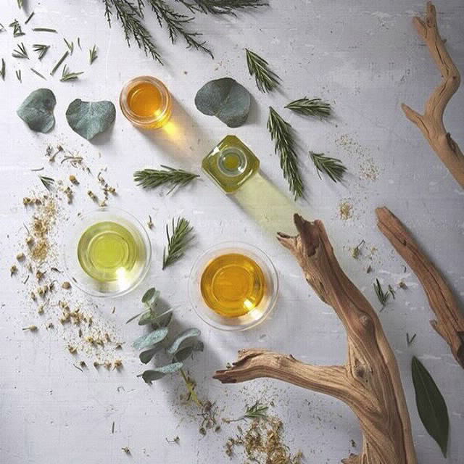
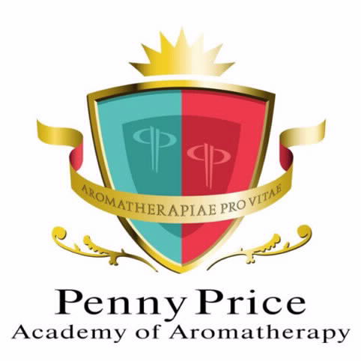
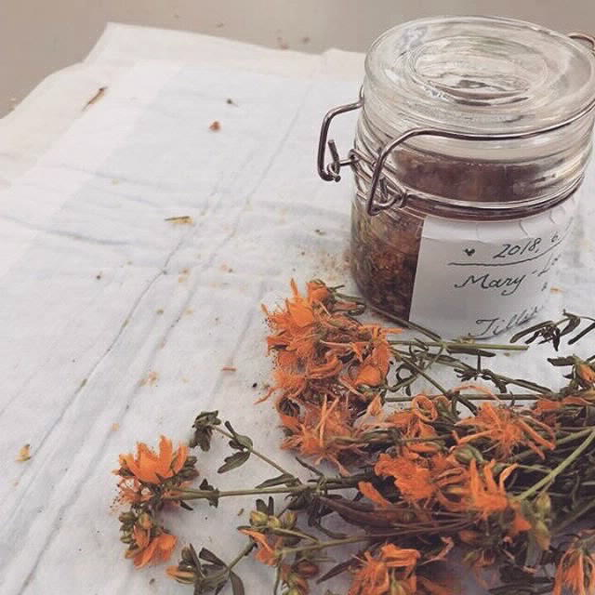
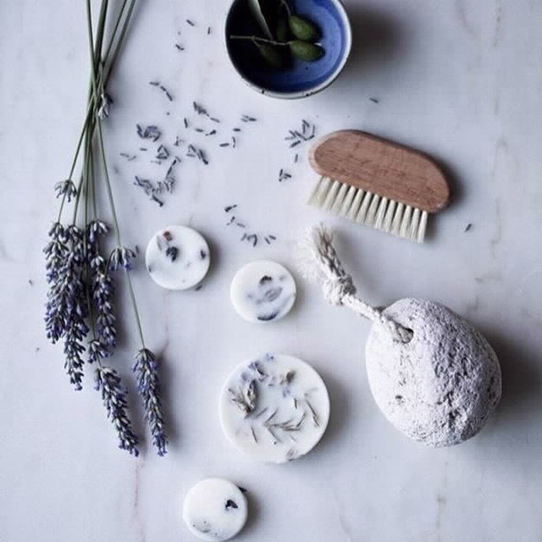
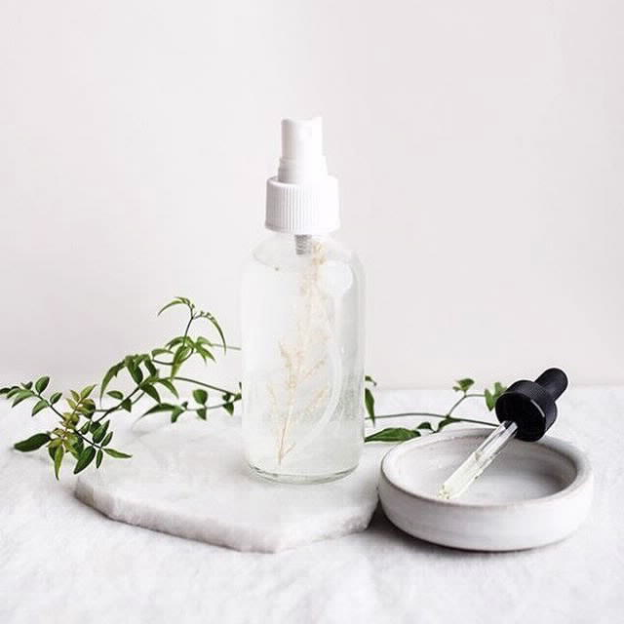
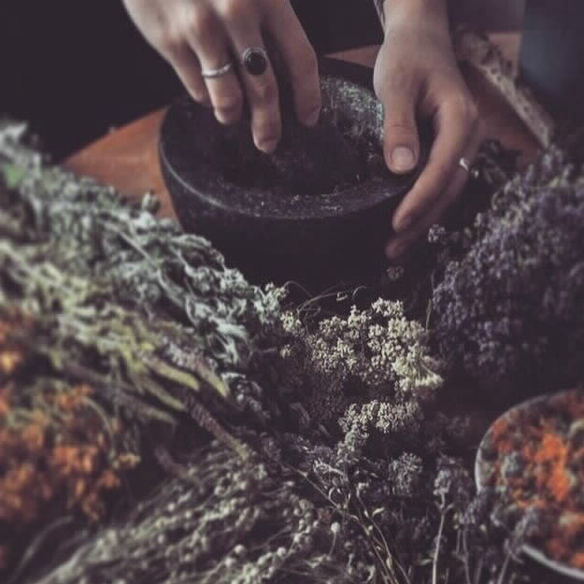
Welcome to…
Penny Price Academy
of Aromatherapy
Saturday Club
Embrace the magic of
Christmas with essential
oils

Slide 2
🎄Why is aromatherapy important at Christmas?🎄
Penny Price Academy
Saturday Club
December 2024
This time of year is all about aromas - fir trees, cooking, citrus fruits, clove, cinnamon etc
Aromatherapy can trigger memories for people reminding them of happy times
All of the commonly used essential oils over this period have both emotional and physical healing properties as well.
We can create blends to uplift spirits, evoke an atmosphere and make us feel better

Slide 3
Using essential oils at Christmas
Penny Price Academy
Saturday Club
December 2024

Slide 4
🎄 Making your house smell more festive 🎄
Penny Price Academy
Saturday Club
December 2024
Christmas cards and wrapping paper - try adding a drop of your favourite Christmas oil to the corner of the wrapping paper.
Also you can dab some on gift tags and inside Christmas cards.
Alternatively leave the wrapping paper or cards overnight in a sealed bag with a cotton ball to which two drops of essential oil have been added.
Wreaths and table decorations - try adding a few drops of essential oil to them to make them smell festive.
Christmas decorations - Enhance Christmas decorations like pinecones, felt ornaments, and fabric stockings with a touch of your favourite aromas.

Slide 5
🎄Room Sprays🎄
Penny Price Academy
Saturday Club
December 2024
Use hydrolats and blends of hydrolats to
create an atmosphere or disinfect a room you can also add some essential oil to the blend:
Frankincense
Myrrh
Oregano
Rosemary
Thyme
Tea tree

Slide 6
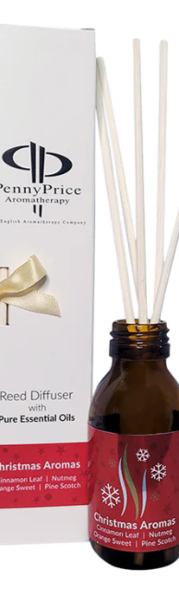
🎄Don’t forget diffusers!🎄
Penny Price Academy
Saturday Club
December 2024
Diffusers are a great way to perfume and deodorise your home.
Try a reed diffuser which will fill your home with the fragrance for weeks. Penny Price’s Christmas reed diffuser contains cinnamon, sweet orange, pine and nutmeg.
An electric diffuser humidifies the air around you while scenting your home. Most will automatically switch off when the water falls below a certain level for your safety.

Slide 7
Penny Price Academy
Saturday Club
December 2024
A Selection of Essential Oils for Christmas

Slide 8
Tangerine (Citrus reticulata blanco)
Penny Price Academy
Saturday Club
December 2024
Tangerine is a variety of the same species as mandarin so they are very similar. Tangerines are harvested in November making them perfect for this season
The oil is very gentle and safe with a light, tangy scent suitable for everyone.
Physically and mentally it is cleansing, uplifting and refreshing.
In common with all citrus oils it has a tonic but calming effect on the digestive system and can be used for flatulence.
It is also an astringent so is recommended for acne, congested and oily skin.

Slide 9
Canadian Balsam (Abies balsamea)
Penny Price Academy
Saturday Club
December 2024
The Canadian Balsam tree is native to Canada where is cut and sold for Christmas trees.
The main chemical constituents found in Balsam Fir are Beta-pinene and Alpha-pinene, which are very cleansing. When diffused it will help to purify the air in the room. It is also said to be cleansing for the skin.
The essential oil is soothing for coughs, sore throats, colds, and flu, especially when there is congestion, so it is ideal for this time of year.
Canadian balsam is also an immunostimulant

Slide 10
Canadian Balsam (Abies balsamea)
Penny Price Academy
Saturday Club
December 2024
This oil warms and relieves sore, stiff muscles and joints. It is ideal for arthritis especially if it is combined with plai and perhaps sweet orange both of which are anti-inflammatory.
It also has an uplifting quality which makes it useful for depression and stress
Fir essential oils have stimulating properties which will help with fatigue, nervous exhaustion or the daily stresses of life.

Slide 11
Cinnamon Leaf (Cinnamomum verum)
Penny Price Academy
Saturday Club
December 2024
Cinnamon has a warming and antispasmodic effect on the body, and can be used in a blend for easing muscular aches and pains, arthritis and rheumatism.
A stomach massage with a blend containing cinnamon can help a sluggish digestion especially when aggravated by cold food.
Diffuse some cinnamon into the air to help ease coughs and colds and stop them from spreading as it is highly antiseptic.
Cinnamon is good for drowsiness and can boost energy levels if you are suffering from exhaustion or burn-out. Blend it with ginger and lemon essential oil for an instant pick me up.
Battaglia states that this oil is beneficial during convalescence as it warming and uplifting but always use in very low dilutions as it can be a skin irritant.

Slide 12
🎄Christmas blend for wreaths/table decorations🎄
Penny Price Academy
Saturday Club
December 2024
These three oils blend beautifully together:
Canadian Balsam is reminiscent of Christmas trees, Cinnamon has that spicy warm aroma
Tangerine softens and sweetens the blend.
Just put a few drops neat onto the decoration or using a plant spray bottle, you can add them to water, shake and spray on to the decoration or around the room before your guests are due to arrive.
Do not spray near a naked flame as oils are highly flammable.

Slide 13
Pine (Pinus sylvestris)
Penny Price Academy
Saturday Club
December 2024
Pine is a powerful pulmonary antiseptic and a good expectorant, so use it in steam inhalations for colds and flu and the coughs associated with them, as well as for bronchitis.
This oil has a stimulating effect on the circulation and can help relieve the pain of arthritis and overworked and tight muscles. It blends beautifully with sweet orange for this.
Its action as an adrenal cortex stimulant enhances the general tonic effect on the body and it ranks alongside rosemary and thyme as one of the most effective oils for fatigue and nervous debility.
Fischer Rizzi recommends it following an illness that leaves one feeling weak and debilitated.

Slide 14
Pine (Pinus sylvestris)
Penny Price Academy
Saturday Club
December 2024
Mojay suggests that this oil is psychologically fortifying. Pine “opens up the chest, instils positivity and helps restore self-confidence …it disperses melancholy and counteracts pessimism, working to reawaken our instinctive connection to life”
Worwood suggests that if you want to refresh the smell of your Christmas tree, spray it with a mixture of 300 mls of water to which 6 drops of pine oil has been added.
Also try putting pine cones in a large plastic bag with a ball of cotton wool to which you have added 2 drops of pine oil. Seal the bag and leave overnight, in the morning you can decorate them with ribbons . These ribbons can be dipped in 250 mls of water to which 6 drops of a citrus oil has been added, they can then be dried.

Slide 15
🎄A beautiful blend to recreate the aromas of Christmas🎄
Penny Price Academy
Saturday Club
December 2024
Add these three oils to a diffuser or to your Christmas decorations to enhance the smell of your home over the festive period.
Cinnamon
Nutmeg
Canadian Balsam or Pine

Slide 16
Juniper Berry (Juniperus communis)
Penny Price Academy
Saturday Club
December 2024
Because it helps the body to eliminate toxins, in particular, uric acid, juniper is a very important oil in treating arthritis, gout and rheumatism especially when the pain is of a cold, cramping nature. It is also a diuretic which helps detoxification.
This oil is a good domestic disinfectant during epidemics (use in a spray). It can also be used to freshen the air.
Juniper berry oil can help with cases of stress, anxiety and general burn-out. Its overall effect on the emotional system is one of strengthening and cleansing, helping to dispel negative emotions such as insecurity, loneliness, sadness and guilt.

Slide 17
Lemon (Citrus Limon)
Penny Price Academy
Saturday Club
December 2024
Lemon oil produces an alkaline reaction in the body and is of great value in the treatment of all conditions which indicate an excess of acidity in the system particularly rheumatism, gout and arthritis.
Lemon oil has the ability to stimulate white blood cells which protect the body against infection.
It is also an antiviral oil, and is indicated for coughs and colds especially where characterised by yellow or green catarrh.
In addition, it is an aerial antiseptic making it excellent for airborne viruses and to protect the family against epidemics.

Slide 18
Lemon (Citrus Limon)
Penny Price Academy
Saturday Club
December 2024
As you might expect due to its use in cleaning products lemon is cleansing both physically and mentally.
Vaporising lemon oil helps to clear the mind and sharpen focus, as was illustrated in a Japanese study which showed that whilst diffusing lemon oil throughout a busy office building, typing errors had decreased by 54%.
It is also said to help to dispel negative emotions such as guilt, jealousy and regret.
Mojay states that Lemon ‘rescues a mind bogged down by burdens decisions and obstacles’.

Slide 19
🎄A blend to clean and refresh a room🎄
Penny Price Academy
Saturday Club
December 2024
If, towards the end of the day, your room feels overcrowded and smells a little stale or if there are germs around try diffusing the following three oils:
Pine - cleansing and invigorating, smells like Christmas
Juniper - an excellent disinfectant
Lemon - an aerial antiseptic

Slide 20
Sweet Orange (Citrus sinensis)
Penny Price Academy
Saturday Club
December 2024
Peter Holmes describes the actions of sweet orange as ‘moderate and ideal for any conditions needing a gentle touch.’
It has a normalising effect on the muscular actions of the stomach, therefore can be used to help with constipation as well as diarrhoea. It is a tonic of the digestive system and its antispasmodic and carminative properties make it suitable for the treatment of types of stomach issues.
In 2009 a study published in the European Journal of Medical Research found that orange oil demonstrated the most anti-inflammatory properties of essential oils. It is therefore recommended for any inflammatory condition.

Slide 21
Sweet Orange (Citrus sinensis)
Penny Price Academy
Saturday Club
December 2024
Orange is one of several oils that can be used to combat insomnia, particularly if it is caused by stress or depression.
Because of its cheery aroma orange is the perfect oil for people who suffer from SAD or winter blues. It is also a general anti-depressant and can be used for stress or over-anxiety making it ideal for Christmas!
A 2014 study published in the Journal of Complementary Therapies of Medicine found that olfactory stimulation using orange and rose oils induces physiological and psychological relaxation. They found that this oil increased ‘comfortable, relaxed and natural feelings.’

Slide 22
Ho (Ho ho!!) Leaf (Cinnamomum camphora c.t. linalool)
Penny Price Academy
Saturday Club
December 2024
This oil is high in the component linalool and is almost chemically identical to Rosewood so can be used instead.
Ho Leaf is a good anti-infective and is useful for respiratory, intestinal and other infections where it is equally anti-bacterial, antiviral and antifungal.
Penny Price recommends it for relieving topical pain (such as sunburn) and as a skincare active (for problem skin and for relieving skin stress). ‘It can be helpful to relieve the itching and redness of acne, and help with candida, dermatitis, dry skin, eczema, scar tissue and stretch marks.

Slide 23
Ho Leaf (Cinnamomum camphora c.t. linalool)
Penny Price Academy
Saturday Club
December 2024
In an article in Aromatherapy Today (1998) John Kerr recommended it ‘when someone is feeling weary and overburdened with problems’ as it is so calming.
Peter Holmes says that it ‘acts as a nervous restorative for weak conditions with fatigue.’
The main chemical component, linalool has been found to have a relaxing effect, and inhalation of linalool vapours does have a sedating effect producing calmness and sleepiness. Using one or two drops on the pillow at night to induce sleep works in much the same way as Lavender essential oil, which also contains linalool.

Slide 24
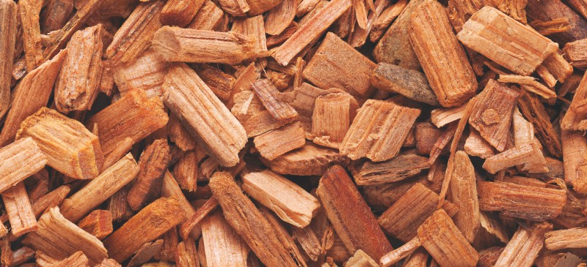
Cedarwood (Cedrus atlantica)
Penny Price Academy
Saturday Club
December 2024
In common with canadian balsam and pine, cedarwood smells like Christmas!
Fatigue can really set in during December due to the short days and the stress which the festivities often produce. Cedarwood is excellent for lethargy and can also help with insomnia.
Cedarwood is a very good oil for treating catarrh and chronic bronchitis where it will kill bacteria and act as a decongestant, it is especially useful when mucus has accumulated in the lungs leading to infection.
Cedarwood is said to help with insecurity, giving strength and fortitude.

Slide 25
🎄Blend to help you sleep🎄
Penny Price Academy
Saturday Club
December 2024
Try diffusing these three oils in your bedroom or night. Also don’t forget that a warm bath an hour or two before bedtime can help a person unwind and fall asleep faster as it will help lower core temperature which is a circadian sleep signal.
To 10 mls of unperfumed foam bath add a total of 4-7 drops of:
Sweet Orange - good for insomnia especially if caused by stress
Ho Leaf - a sedative
Cedarwood - calming and good for stress

Slide 26
Frankincense (Boswellia carterii)
Penny Price Academy
Saturday Club
December 2024
Frankincense possesses anti-catarrhal and expectorant properties, which make it useful for bronchitis and asthma, especially when associated with nervous tension.
It is one of the best oils for treating dull, wrinkled or ageing skin. The Egyptians used it in rejuvenating face masks, and it does really seem to have a rejuvenating effect.
It is a cytophylactic/anti-oxidant oil so is useful not only for mature skins but also scars and stretch marks.

Slide 27
Frankincense (Boswellia carterii)
Penny Price Academy
Saturday Club
December 2024
It is a valuable oil for its effect on the mind being both soothing and stimulating at once, it can help the depressed person to get moving again. It seems to be particularly helpful for people suffering from the effects of traumatic experiences in their past.
On a day-to-day level it may be used for states of mental agitation and worry, or whenever the mind is distracted and overwhelmed by too many thoughts.
Frankincense is a beautiful oil for helping you sleep when the mind is overactive.

Slide 28
Nutmeg (Myristica fragrans)
Penny Price Academy
Saturday Club
December 2024
The essential oil of Nutmeg is indicated for cold, damp and weak conditions.
Physically it is useful for both acute and chronic rheumatic pain (eg arthritis) where it is an analgesic as well as an anti-inflammatory. In addition it is a circulatory stimulant.
Nutmeg is reputed to be one of the best essential ois for digestive and intestinal conditions. It is recommended for conditions such as colitis, and inflammatory bowel disease and is a particularly effective remedy for diarrhoea.
Nutmeg is also recommended for general fatigue

Slide 29
Nutmeg (Myristica fragrans)
Penny Price Academy
Saturday Club
December 2024
Nutmeg has been found to be a MAO inhibitor (Faucon 2016) which means it helps treat depression, this can be very useful at this time of year.
Peter Holmes states that the fragrance is for those who feel weak, vulnerable, unprotected and easily hurt by others.
Diffusing Nutmeg is reputed to bring calm and comfort into the home, a beautiful ambience for Christmas.
Do not use on sensitive skin or in large doses as it is reputed to cause hallucinations, paranoia and vomiting!

Slide 30
🎄Another Christmas blend for the house 🎄
Penny Price Academy
Saturday Club
December 2024
Try this fresh, citrusy and spicy blend to make your house smell more festive:
Add
4 drops of pine
2 drops of tangerine
1 drop of cinnamon
1 drop of frankincense
to 300 mls of water and spray around your rooms
(Valerie Ann Worwood)

Slide 31
Penny Price Academy
Saturday Club
December 2024
Beautiful Christmas Blends

Slide 32
As well as diffusing the following oils, you can add these blends to a nasal inhaler for the person to sniff when they need some extra support or in an evening bath to help them relax
Add a total of 6 drops (2 drops of each) of them to 10 mls of carrier oil and either put them in a roller ball to apply to their pulse points or use as a massage oil to help with a variety of issues
.
To make a massage blend add a total of 3 drops of essential oils to 10 mls or either carrier oil or white lotion.
Penny Price Academy
Saturday Club
December 2024

Slide 33
Blend for Joint Pain
2 drops of Juniper
2 drops of Lemon
1 drop of Canadian Balsam
1 drop of Nutmeg
Penny Price Academy
Saturday Club
December 2024
Blend for Christmas Coughs and Colds
2 drops Lemon
2 drops Frankincense
2 drops Pine
Happy Christmas Boost (for fatigue)
2 drops of Canadian Balsam
2 drops of Cedarwood
2 drops of Juniper
Post Christmas Calm for Digestive Issues
2 drops Sweet orange
1 drop Nutmeg or cinnamon
2 drops Marjoram

Slide 34
Recommended books
Penny Price Academy
Saturday Club
December 2024
Gabriel Mojay - Aromatherapy for Healing the Spirit: Restoring Emotional and Mental Balance with Essential Oils
Peter Holmes - Aromatica: A Clinical Guide to Essential Oil Therapeutics. Principles and Profiles vols 1 and 2
Salvatore Battaglia - The Complete Guide to Aromatherapy
Fischer - Rizzi - Complete Aromatherapy Handbook
Valerie Ann Worwood - The Fragrant Pharmacy

Slide 35
Save 10% on the following Essential Oils
Tangerine Canadian Balsam Cinnamon Leaf Pine Juniper Berry Lemon Sweet Orange Ho Leaf Cedarwood Atlas Frankincense Nutmeg Marjoram
Use Code CHRISTMASCLUB

Slide 36
Thank you…
Penny Price Academy
of Aromatherapy
Saturday Club

